Slide 2
Chapter 1
The Basics and the Body

Slide 3
What Is Medical Terminology?
Medical terminology can be considered a language
Knowing the meanings of common word parts can help you decode the meanings of words
kentoh/Shutterstock.com

Slide 4
Word Parts
Root word—the central part of a medical word
Combining vowel—the vowel attached to the end of a root word
Combining form—a root word plus a combining vowel
For example, glyc (root word) + o (combining vowel) = glyc/o (combining form)
(Continued)

Slide 5
Word Parts
Prefix—a single letter or group of letters attached to the front of a root word
Suffix—a single letter or group of letters attached to the end of a root word

Slide 6
Reading a Medical Term
Identify word parts
Find the meaning of each word part
Put meanings together to form a definition
Prefix |  | Root Word |  | Suffix |  | Medical Term
hypo- | + | glyc | + | -emia | = | hypoglycemia
below normal; deficient | + | sugar; glucose | + | blood condition | = | blood condition of below-normal sugar

Slide 7
Pronouncing Medical Terms
Letter(s) | Pronunciation | Example
ae | ay igh | vertebrae pleurae
c | s (before e, i, or y) | cyst
ch | k | chronic
g | j (before e, i, or y) | generic
i | eye | fungi
ps | s | psychology
pn | n | pneumonia

Slide 8
Singular and Plural Spellings
Singular → Plural | Example (Singular) | Example (Plural)
-a → -ae | larva | larvae
-ax → -aces | thorax | thoraces
-ex → -ices | index | indices
-is → -es | prosthesis | prostheses
-ix → -ices | appendix | appendices
(Continued)

Slide 9
Singular and Plural Spellings
Singular → Plural | Example (Singular) | Example (Plural)
-ma → -mata | condyloma | condylomata
-on → -a | ganglion | ganglia
-um → -a | atrium | atria
-us → -i | bronchus | bronchi
-y → -ies | myopathy | myopathies

Slide 10
Your Turn
What are the plural forms of the following words?
thorax
thoraces
appendix
appendices
atrium
atria
myopathy
myopathies

Slide 11
Combining Forms
Combining Form | Meaning | Combining Form | Meaning
arthr/o | joint | hepat/o | liver
cardi/o | heart | infer/o | below
cephal/o | head | log/o | study
cost/o | rib | neur/o | nerve
gastr/o | stomach | super/o | above

Slide 12
Prefixes
Prefix | Meaning
ante- | before
bi- | two; both
endo- | in; within
hypo- | below; below normal; deficient
peri- | around; surrounding
tachy- | fast

Slide 13
Suffixes
Suffix | Meaning
-algia | pain
-emia | blood condition
-itis | inflammation
-logy | study of
-osis | abnormal condition
-tomy | process of cutting; incision

Slide 14
Your Turn
What are the meanings of the following word parts?
anter/o
front
cervic/o
neck; cervix
poster/o
back; behind
brady-
slow
intra-
within; into
-cyte
cell
-oma
tumor; mass
-pathy
disease

Slide 15
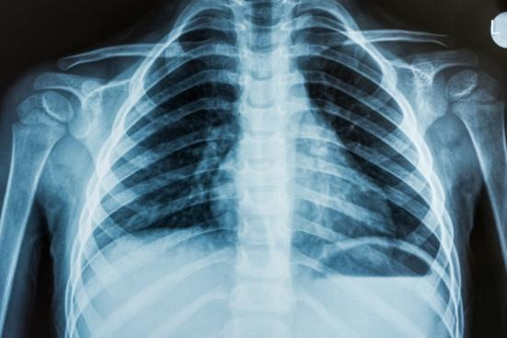
Descriptive Terms
Anatomy—the study of the structures of the body
Physiology—the study of the functions of body structures
Pathophysiology—the study of disease
OZMedia/Shutterstock.com

Slide 16
Anatomical Position
Used when referencing location, position, and direction of the body
Standing upright, head and feet facing forward, arms at sides, palms facing forward
© Body Scientific International

Slide 17
Major Views of the Human Body
© Body Scientific International

Slide 18
Anatomical Planes
© Body Scientific International

Slide 19
Remember This?
Which plane divides the body into equal left and right halves?
midsagittal plane
Which plane divides the body into upper and lower sections?
transverse plane

Slide 20
Terms for Anatomical Location, Position, and Direction
Anterior—head end
Ventral—belly side
Posterior—tail end or rear
Dorsal—back of the body
Medial—near the midline
Lateral—near the side of the body
(Continued)

Slide 21
Terms for Anatomical Location, Position, and Direction
Proximal—near the point of origin
Distal—away from the point of origin
Superior—closer to the top of the head
Inferior—closer to the soles of the feet
Cephalic—near the head
Caudal—near the tail or inferior end

Slide 22
Terms of Position
Erect
Fowler’s position
Knee-chest
Lateral
Prone
Sims’ position
Supine
© Body Scientific International

Slide 23
Remember This?
What word means “near the midline or center of the body”?
medial
What is the name of the body position used for CT and MRI scans?
supine position

Slide 24
Body Cavities
© Body Scientific International

Slide 25
Abdominal Quadrants
© Body Scientific International

Slide 26
Abdominal Regions
© Body Scientific International

Slide 27
Remember This?
Which body cavity protects the heart and lungs?
thoracic cavity
What is the name of the abdominal region that contains the belly button?
umbilical region

Slide 28
Organization of the Body
© Body Scientific International

Slide 29
Cells
Specialized cells include muscle cells, epithelial cells, fat cells, and nerve cells
Cell division occurs through mitosis (most cells) or meiosis (sex cells)

Slide 30
Tissues
Epithelial tissue—forms skin, organ linings, and some glands
Connective tissue—supports and connects organs and body tissues
Muscle tissue—contracts to produce bodily movement
Nervous tissue—receives and conducts electrochemical impulses

Slide 31
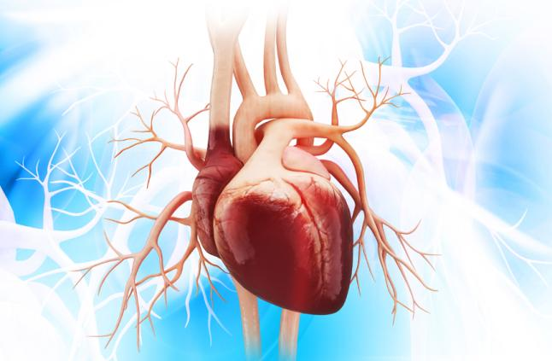
Organs
Composed of several kinds of tissue that work together to perform a specific function
For example, the heart is composed of muscle, connective, nervous, and epithelial tissue
Liya Graphics/Shutterstock.com

Slide 32
Body Systems
Integumentary
Skeletal
Muscular
Nervous
Endocrine
Respiratory
Cardiovascular
Lymphatic
Digestive
Urinary
Reproductive (male and female)

Slide 33
Remember This?
Which body system is shown here?
lymphatic system
© Body Scientific International

Slide 34
Descriptive Terms for Diseases and Conditions
Acute
Autoimmune
Benign
Chronic
Congenital
Convalescence
Debilitating
Endemic
Endogenous
Epidemic
Exogenous
Genetic
Hypersensitivity
Iatrogenic
(Continued)

Slide 35
Descriptive Terms for Diseases and Conditions
Idiopathic
Immunological
Infectious
Inflammatory
Ischemic
Malignant
Metabolic
Neoplastic
Nosocomial
Nutritional
Opportunistic
Syndrome
Terminal

Slide 36
Your Turn
Define the following descriptive medical terms:
chronic
long duration and slow progression
debilitating
having a weakening or fatiguing effect
ischemic
caused by temporary deficiency in blood flow
terminal
treatments but no cure; fatal

Slide 37
Assessment Terms
Observation
Manifestation
Inspection
Auscultation
Palpation
Percussion
Olfaction
Diagnostic testing
NPFire/Shutterstock.com

Slide 38
Remember This?
What is the difference between signs and symptoms?
Signs are objective observations made by healthcare professionals; symptoms refer to a patient’s awareness of abnormalities or discomfort; signs can be observed and measured; symptoms can be neither observed nor measured

Slide 39
Common Medical Abbreviations
Abbreviation | Meaning
abd | abdominal
c/o | complains of; complaining of
CXR | chest X-ray
ER | emergency room
ht | height
OB/GYN | obstetrician/gynecologist

Slide 40
Your Turn
Identify the meanings of the following medical abbreviations:
AAF
African-American female
CBC
complete blood (cell) count
NKDA
no known drug allergies
NPO
nothing by mouth

Slide 41
Military Time
© Body Scientific International

Slide 42
Your Turn
Convert the following times to military or conventional time:
1:45 a.m.
0145
2:15 p.m.
1415
0927
9:27 a.m.
1605
4:05 p.m.

