Slide 2
Chapter 2
The Skeletal System

Slide 3
THE SKELETAL SYSTEM What are the functions & structures of this system?

Slide 4
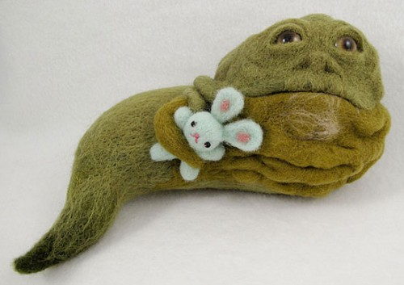
FUNCTIONS OF THE SKELETAL SYSTEM
Framework (what structures make this?)
Protection of internal organs (How?)

Slide 5
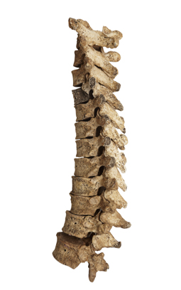
Functions of Bone
Support
Protection
Mineral storage
Blood cell formation
Anchoring and movement of muscles
Picsfive/Shutterstock.com

Slide 6
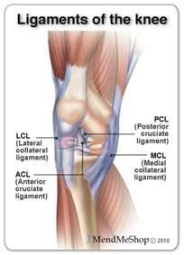
Parts of the Skeletal System
Bones: rigid dense organs that protect and support the body
Joints: sites where bones
join together
Ligaments: bands of tissue
connect bone to bone

Slide 7
Label the Bones:
maxilla
mandible

Slide 8
Types and Shapes of Bones →Know examples of each (try to list as many as possible)
humerus
sternum
vertebrae
phalanges
metacarpals
patella
© Body Scientific International

Slide 9
Parts of the Skeleton

Slide 10
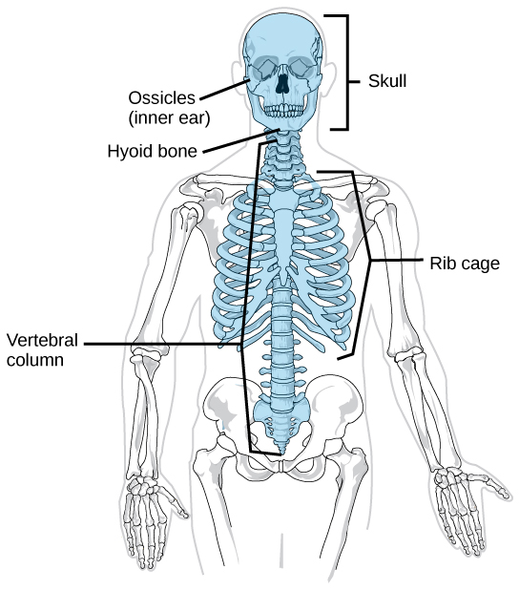
Axial Skeleton
Skull (facial bones)
Thoracic “Rib” cage
Vertebral column
Arcady/Shutterstock.com

Slide 11
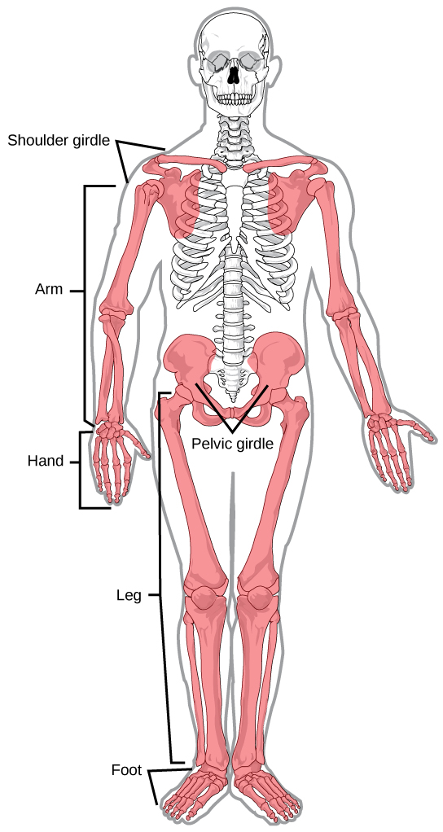
Appendicular Skeleton
Shoulder girdle
Upper extremities (arms and hands)
Pelvic girdle
Lower extremities (legs and feet)
Stefan Weichelt/Shutterstock.com

Slide 12
Skeletal Vocab: Define using textbook
What is the medical name for each of the following bones?
Shin
Collar bone
Funny bone
Heel
Shoulder blade
Breast bone
Lower jaw
Upper jaw
Skull
Knee cap

Slide 13
Diseases and Conditions *Using your “terms” figure out each disease:
Osteosarcoma
oste / o / sarc / oma
Scoliosis
scoli / osis
Subluxation
sub / lux / ation
Scoliosis
© Body Scientific International

Slide 14
Diseases and Conditions
Myeloma
myel / oma
Ostealgia
oste / algia
Osteomyelitis
oste / o / myel / itis
Osteomyelitis
(Continued)
© Body Scientific International

Slide 15
What am I (bones)…..
I am distal to the femur, on the anterior side of the leg, and superior to the tibia
I am distal to the carpals and proximal to the phalanges
I am inferior to the cranium but superior to the mandible
I am on the ventral side of the body, medial to the ribs, anterior to the vertebrae

Slide 16
Abbreviations (page 51)
Add to your journal and define
ATT PHYS
BP
CRIF
CT
CV
DJD
GI
L
LBP
LS
L5-S1
Mg
MRI
NSAID
ORIF
PO, po
PRN, prn
Q4H
R
RA
RF

Slide 17
Therapeutic Drug Treatments
Add to your journal and define
Analgesic
Anti-inflammatory
Antipyretic
Narcotic
Nonsteroidal anti-inflammatory drug (NSAID)

Slide 18
Your Turn
A 15-year-old has a bad cold. He complains of aching and has a temperature of 102.4°.
Which class of drug might lower his temperature?
antipyretic
Which class of drug might reduce body aches?
analgesic or narcotic

Slide 19
Remember This?
A 63-year-old woman trips over a rug and falls, breaking her femur and fibula. Her physician is concerned that she may have osteoporosis. What diagnostic test should the physician order to confirm this diagnosis?
bone density test

