Slide 2
Chapter 2
The Skeletal System

Slide 3
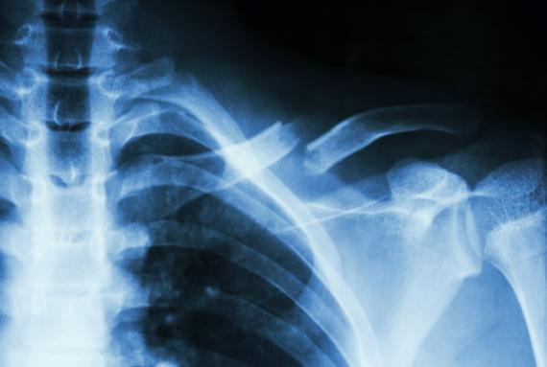
Medical Terms and the Skeletal System
Many word parts pertain specifically to the skeletal system, including those related to
anatomy and physiology
pathology
diagnosis and treatment
Puwadol Jaturawutthichai/Shutterstock.com

Slide 4
Combining Forms
Combining Form | Meaning | Combining Form | Meaning
acr/o | extremities | orth/o | straight
brachi/o | arm | ped/o | foot; child
chondr/o | cartilage | pyret/o | fever
crani/o | skull | sacr/o | sacrum
kyph/o | humpback | tars/o | ankle

Slide 5
Prefixes
Prefix | Meaning
a-, an- | not; without
inter- | between
meta- | change; beyond
non- | not
sub- | below; under
supra- | above

Slide 6
Suffixes
Suffix | Meaning
-al, -ic | pertaining to
-ation | process; condition
-ectomy | surgical removal; excision
-penia | deficiency
-plasty | surgical repair
-scope | instrument used to view

Slide 7
Your Turn
peri-
around; surrounding
-algia
pain
-malacia
softening
-tomy
incision
What are the meanings of the following word parts?
arthr/o
joint
cervic/o
neck; cervix
narc/o
numbness; stupor
anti-
against

Slide 8
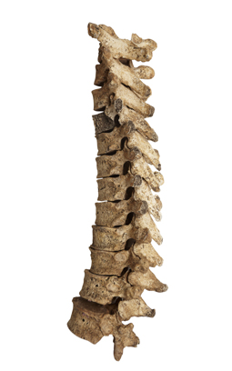
Functions of Bone
Support
Protection
Mineral storage
Blood cell formation
Anchoring and movement of muscles
Picsfive/Shutterstock.com

Slide 9
Types and Shapes of Bones
© Body Scientific International

Slide 10
Bone Composition
Cortical bone
Also called compact bone
Dense, hard, and strong
Lies under periosteum
Contains medullary cavity, which houses yellow bone marrow
(Continued)

Slide 11
Bone Composition
Cancellous bone
Also called trabecular bone
Porous and less dense
Mainly found in epiphyses of long bones
Contains red bone marrow, where hematopoiesis (production of red blood cells) occurs

Slide 12
Remember This?
Epiphysis
Identify the cortical and cancellous bone in this illustration.
Which parts of this bone make up the diaphysis?
Which parts make up the epiphysis?
Cancellous bone
Cortical bone
Diaphysis
Epiphysis
© Body Scientific International

Slide 13
Types of Joints
Diarthroses—freely movable
Amphiarthroses—slightly movable
Synarthroses—immovable
Synovial joints—contain bursa sac
© Body Scientific International

Slide 14
Six Types of Diarthroses
© Body Scientific International

Slide 15
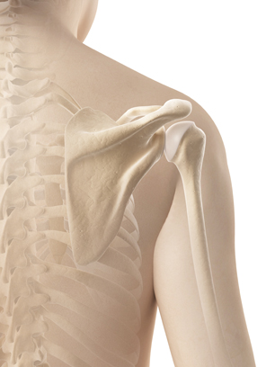
Remember This?
Which type of joint is shown here?
ball-and-socket (diarthrotic) joint
Sebastian Kaulitzki/Shutterstock.com

Slide 16
Bone Processes
© Body Scientific International

Slide 17
Bone Depressions
© Body Scientific International

Slide 18
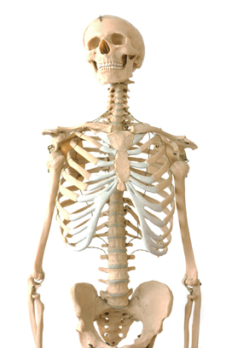
Axial Skeleton
Skull (cranium and facial bones)
Thoracic cage (sternum and costals)
Vertebral column (C-spine, T-spine, L-spine, S-spine, and coccyx)
Arcady/Shutterstock.com

Slide 19
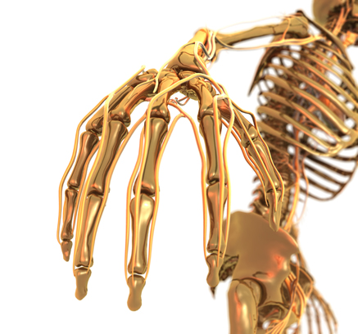
Appendicular Skeleton
Shoulder girdle
Upper extremities (arms and hands)
Pelvic girdle
Lower extremities (legs and feet)
Stefan Weichelt/Shutterstock.com

Slide 20
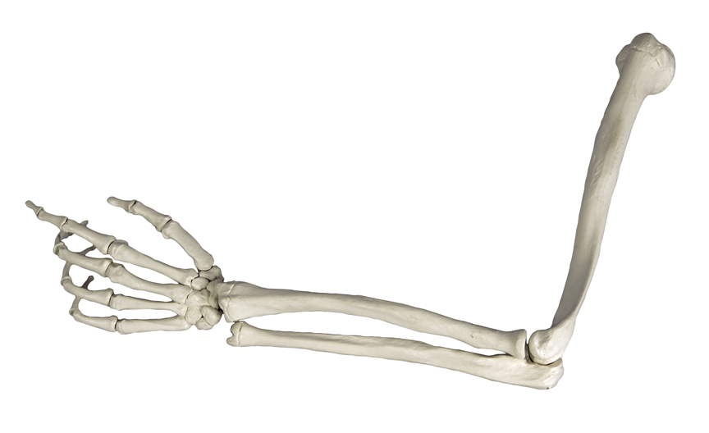
Your Turn
Identify the bones in this illustration.
Metacarpals
Humerus
Radius
Phalanges
Ulna
Henri et George/Shutterstock.com

Slide 21
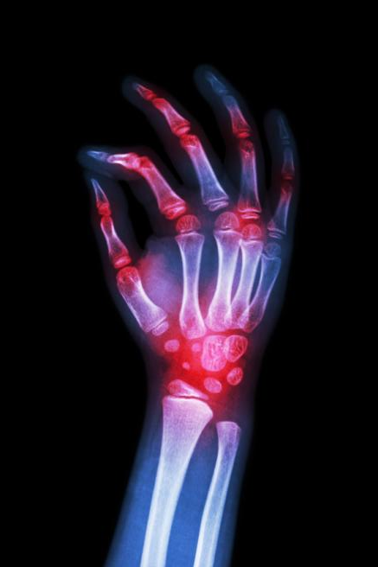
Diseases and Conditions
Ankylosis
ankyl / osis
Osteoarthritis
oste / o / arthr / itis
Rheumatoid arthritis (RA)
rheumat / oid
Gout
(Continued)
Puwadol Jaturawutthichai/Shutterstock.com

Slide 22
Diseases and Conditions
Myeloma
myel / oma
Ostealgia
oste / algia
Osteomyelitis
oste / o / myel / itis
Osteomyelitis
(Continued)
© Body Scientific International

Slide 23
Diseases and Conditions
Osteosarcoma
oste / o / sarc / oma
Scoliosis
scoli / osis
Subluxation
sub / lux / ation
Scoliosis
© Body Scientific International

Slide 24
Your Turn
Define each disease or condition and identify the meanings of its word parts:
arthralgia
arthr/o = joint; -algia = pain definition: pain in a joint or joints
bursitis
burs/o = bursa; -itis = inflammation definition: inflammation of the bursa
(Continued)

Slide 25
Your Turn
Define each disease or condition and identify the meanings of its word parts:
osteoma
oste/o = bone; -oma = tumor; mass definition: tumor of the bone
kyphosis
kyph/o = humpback; -osis = abnormal condition definition: abnormal, outward curvature of the thoracic spine

Slide 26
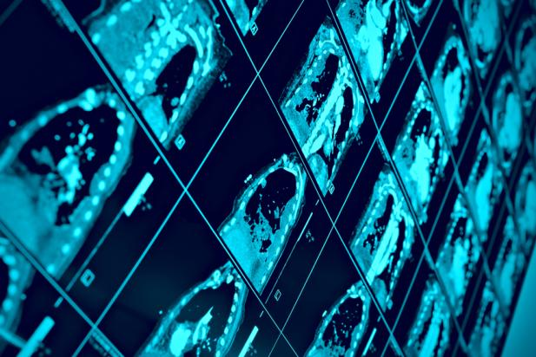
Diagnostic Tests and Procedures
Arthroscopy
arthr / o / scopy
Bone density test
Bone marrow aspiration
Computerized tomography (CT)
Computerized tomography
(Continued)
sfam_photo/Shutterstock.com

Slide 27
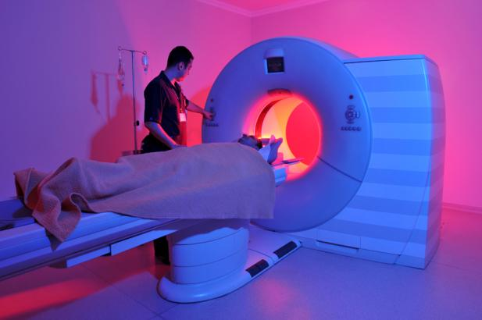
Diagnostic Tests and Procedures
Lumbar puncture
lumb / ar
Magnetic resonance imaging (MRI)
Rheumatoid factor (RF)
rheumat / oid
X-ray
Magnetic resonance imaging
Levent Konuk/Shutterstock.com

Slide 28
Remember This?
A 63-year-old woman trips over a rug and falls, breaking her femur and fibula. Her physician is concerned that she may have osteoporosis. What diagnostic test should the physician order to confirm this diagnosis?
bone density test

Slide 29
Surgical Procedures and Therapeutics
Arthrocentesis
arthr / o / centesis
Bone grafting
Bursectomy
burs / ectomy
Arthrocentesis
(Continued)
© Body Scientific International

Slide 30
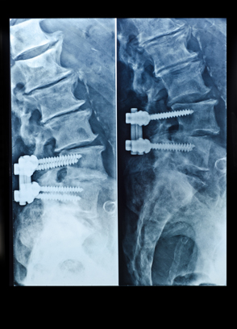
Surgical Procedures and Therapeutics
Diskectomy
disk / ectomy
Spondylosyndesis
spondyl / o / syn / desis
Tenotomy
ten / o / tomy
Spondylosyndesis
Stefania Arca/Shutterstock.com

Slide 31
Your Turn
Define each word and identify the meanings of its word parts:
arthrodesis
arthr/o = joint; -desis = to bind; tie together definition: surgical immobilization of a joint
orthosis
orth/o = straight; -osis = abnormal condition definition: straightening or correction of a bone deformity

Slide 32
Therapeutic Drug Treatments
Analgesic
Anti-inflammatory
Antipyretic
Narcotic
Nonsteroidal anti-inflammatory drug (NSAID)

Slide 33
Your Turn
A 15-year-old has a bad cold. He complains of aching and has a temperature of 102.4°.
Which class of drug might lower his temperature?
antipyretic
Which class of drug might reduce body aches?
analgesic or narcotic

Slide 34
Common Medical Abbreviations
Abbreviation | Meaning
ATT PHYS | attending physician
CRIF | closed reduction and internal fixation
CT | computerized tomography; computed tomography
DJD | degenerative joint disease
PRN | as needed
RA | rheumatoid arthritis

Slide 35
Your Turn
Identify the meanings of the following common medical abbreviations:
LBP
lower back pain
PO
by mouth
RF
rheumatoid factor

