Slide 2
Chapter 3
The Muscular System

Slide 3
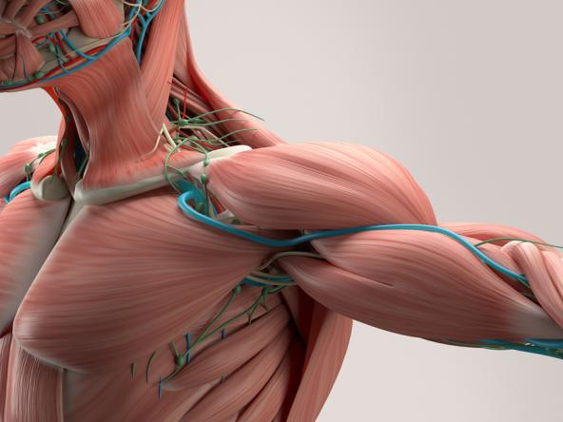
Medical Terms and the Muscular System
Many word parts pertain specifically to the muscular system, including those related to
anatomy and physiology
pathology
diagnosis and treatment
Anatomy Insider/Shutterstock.com

Slide 4
Combining Forms
Combining Form | Meaning | Combining Form | Meaning
articul/o | joint | radi/o | X-rays
electr/o | electricity | son/o | sound
fibr/o | fiber | tax/o | coordination; order
muscul/o | muscle | tens/o | stretched; strained
plant/o | sole of the foot | vers/o | turn; turning

Slide 5
Prefixes
Prefix | Meaning
ab- | away; away from
brady- | slow
dys- | painful; difficult
hemi- | half
hyper- | above; above normal; excessive
in- | in; into; not

Slide 6
Suffixes
Suffix | Meaning
-asthesia | weakness
-cele | hernia; swelling; protrusion
-esthesia | sensation
-ia | condition
-lysis | breakdown; separation; loosening
-rrhexis | rupture

Slide 7
Your Turn
hypo-
below normal
-dynia
pain
-ion
process; condition
-penia
deficiency
What are the meanings of the following word parts?
duct/o
lead; carry
my/o
muscle
sarc/o
connective tissue
circum-
around

Slide 8
Major Muscles
© Body Scientific International

Slide 9
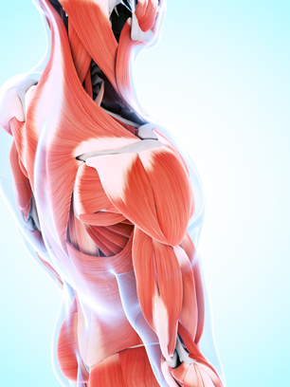
Muscle Tissue Types
Skeletal muscle—voluntary muscle attached to bone; also called striated muscle
(Continued)
Sebastian Kaulitzki/Shutterstock.com

Slide 10
Muscle Tissue Types
Smooth muscle—involuntary muscle surrounding internal organs; also called visceral muscle
Cardiac muscle—involuntary muscle found only in the heart; also called myocardial muscle

Slide 11
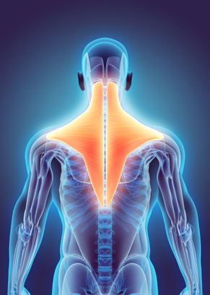
Muscle Tissue Properties
Automaticity
Contractility
Elasticity
Excitability
Extensibility
yodiyim/Shutterstock.com

Slide 12
Origin and Insertion
Origin—attachment site that does not move
Insertion—attachment site that does move
© Body Scientific International

Slide 13
Tendons and Ligaments
Tendons—attach muscle to bone
Ligaments—attach bone to bone
© Body Scientific International

Slide 14
Skeletal Muscle Organization
© Body Scientific International

Slide 15
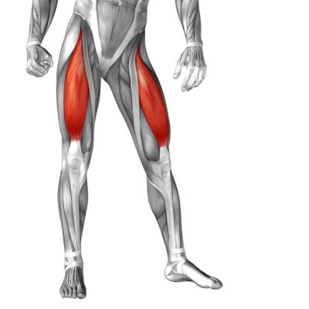
Remember This?
Which property of muscle tissue allows it to contract in response to a nerve impulse?
excitability
Identify the insertion and origin points of the rectus femoris muscles shown in red.
Origin
Insertion
design36/Shutterstock.com

Slide 16
Agonists and Antagonists
Agonist—causes primary movement
Antagonist—works against primary movement
© Body Scientific International

Slide 17
Directional Movements
Elevation
Depression
Flexion
flex / ion
Extension
ex / tens / ion
Abduction
ab / duct / ion
Adduction
ad / duct / ion
Inversion
in / vers / ion
Eversion
e / vers / ion
(Continued)

Slide 18
Directional Movements
Rotation
Pronation
Supination
Circumduction
circum / duct / ion
Hyperextension
hyper / ex / tens / ion
Dorsiflexion
dorsi / flex / ion
Plantar flexion
plant / ar flex / ion

Slide 19
Your Turn
Define each directional term and identify the meanings of its word parts:
adduction
ad- = toward; duct/o = to lead; -ion = process definition: movement toward midline of body
plantar flexion
plant/o = sole of foot; -ar = pertaining to; flex/o = to bend; -ion = process definition: motion of sole of foot away from midline of body

Slide 20
Major Muscles
Frontalis
Trapezius
Pectoralis major
Triceps brachii
Latissimus dorsi
Abdominal muscles
Gluteus medius
Gluteus maximus
Sartorius
Biceps femoris
Rectus femoris
Gastrocnemius
Tibialis anterior

Slide 21
Remember This?
Which muscle is primarily responsible for extending the forearm?
triceps brachii
Which muscle in the posterior calf is responsible for flexing the foot and leg?
gastrocnemius
Which muscle rotates the scapula?
trapezius

Slide 22
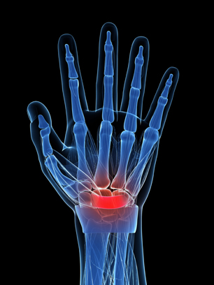
Diseases and Conditions
Adhesion
Atrophy
a / trophy
Carpal tunnel syndrome (CTS)
Dystaxia
dys / tax / ia
Carpal tunnel syndrome
(Continued)
Sebastian Kaulitzki/Shutterstock.com

Slide 23
Diseases and Conditions
Flaccidity
Hypotonia
hypo / ton / ia
Impingement syndrome
Myalgia
my / algia
Impingement syndrome
(Continued)
© Body Scientific International

Slide 24
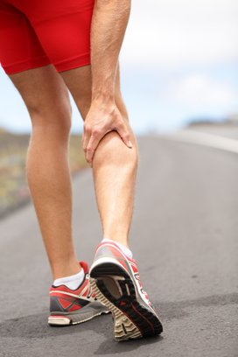
Diseases and Conditions
Myorrhexis
my / o / rrhexis
Rhabdomyoma
rhabd / o / my / oma
Sarcopenia
sarc / o / penia
Spasm
(Continued)
Maridav/Shutterstock.com

Slide 25
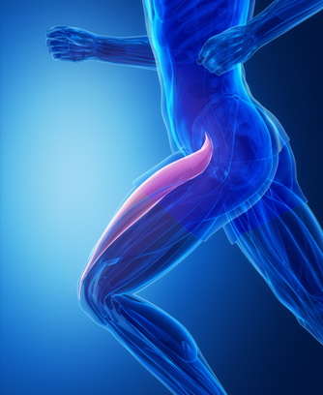
Diseases and Conditions
Strain
Tenalgia
ten / algia
Tetany
Tremor
CLIPAREA | Custom media/Shutterstock.com

Slide 26
Your Turn
Define each disease or condition and identify the meanings of its word parts:
myocele
my/o = muscle; -cele = hernia
definition: herniation or protrusion of muscle through tear in fascia
paresthesia
par- = abnormal; -esthesia = sensation definition: abnormal sensation
(Continued)

Slide 27
Your Turn
Define each disease or condition and identify the meanings of its word parts:
quadriplegia
quadri- = four; -plegia = paralysis definition: paralysis of all four extremities
tendinitis
tendin/o = tendon; -itis = inflammation
definition: inflammation of a tendon

Slide 28
Diagnostic Tests and Procedures
Biopsy
Deep tendon reflexes (DTR)
Electromyogram (EMG)
electr / o / my / o / gram
Goniometry
Deep tendon reflex test
(Continued)
Photographee.eu/Shutterstock.com

Slide 29
Diagnostic Tests and Procedures
Magnetic resonance imaging (MRI)
Nuclear medicine imaging (NMI)
Radiography
radi / o / graphy
Sonography
son / o / graphy
carballo/Shutterstock.com

Slide 30
Remember This?
What information does a DTR test provide?
A DTR test evaluates involuntary muscular responses

Slide 31
Surgical Procedures and Therapeutics
Myoplasty
my / o / plasty
Physical therapy
Range-of-motion (ROM) therapy
RICE
Monkey Business Images/Shutterstock.com

Slide 32
Therapeutic Drug Treatments
Analgesic
Anti-inflammatory
Antispasmodic (anticholinergic)
Narcotic
Nonsteroidal anti-inflammatory drug (NSAID)

Slide 33
Your Turn
A member of a high school basketball team strains a muscle in her left leg while making a play. What first-aid measures would the coach most likely take?
RICE (Rest, Ice, Compression, Elevation)

Slide 34
Common Medical Abbreviations
Abbreviation | Meaning
amb | ambulate (walk)
CPR | cardiopulmonary resuscitation
DMD | Duchenne muscular dystrophy
h | hour(s)
PCN | penicillin
PT | physical therapy

Slide 35
Your Turn
Identify the meanings of the following common medical abbreviations:
CTS
carpal tunnel syndrome
DTR
deep tendon reflex
RMS
rhabdomyosarcoma

