Slide 1
THE MUSCULAR SYSTEM

Slide 2
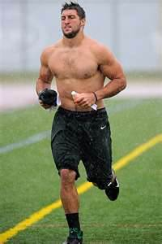
FUNCTIONS OF THE MUSCULAR SYSTEM
FUNCTIONS:
Movement
Protection of internal organs
Produces heat

Slide 3
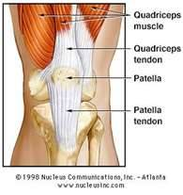
STRUCTURES
MUSCLES
  Tissue that aids in movement
TENDONS
  Strong bands of tissue connecting muscle to bone

Slide 4
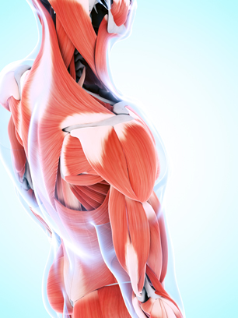
Muscle Tissue Types
Skeletal muscle—voluntary muscle attached to bone; also called striated muscle
(Continued)
Sebastian Kaulitzki/Shutterstock.com

Slide 5
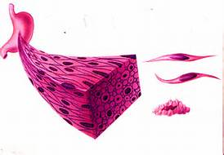
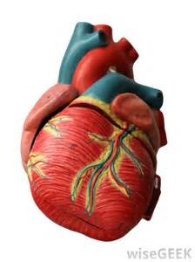
Muscle Tissue Types
Smooth muscle—involuntary muscle surrounding internal organs; also called visceral muscle
Cardiac muscle—involuntary muscle found only in the heart; also called myocardial muscle

Slide 6
Major Muscles
© Body Scientific International

Slide 7
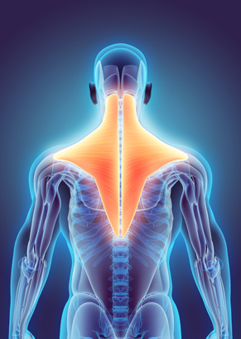
Muscle Tissue Properties
Automaticity: ability to contract without a nerve impulse
Contractility: ability to shorten
Elasticity: ability to return to normal position after being stretched
Excitability: ability to receive and respond to nerve impulse by contracting
Extensibility: ability to be stretched
yodiyim/Shutterstock.com

Slide 8
Origin and Insertion Sites of Muscles
Origin—attachment site that does not move
Insertion—attachment site that does move
© Body Scientific International

Slide 9
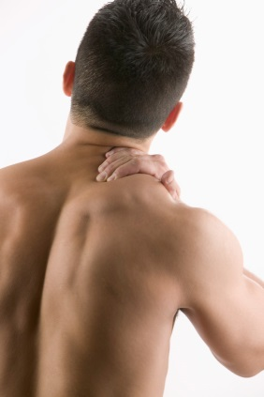
WHAT’S THE DIFFERENCE????
STRAIN (muscular)
  injuries that involve the stretching or tearing of a muscle and/or tendon
  Example: lifting something too heavy and hurting your back
SPRAIN (skeletal)
  an injury involving the stretching or tearing of a ligament
  Example: twisting your ankle when running

Slide 10
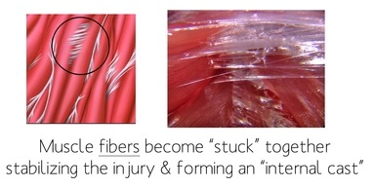
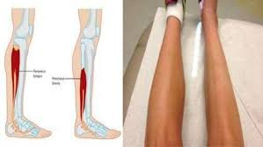
Diseases and Conditions
Adhesion: injured tissue sticks together as it heals
Atrophy: shrinkage of muscle

Slide 11
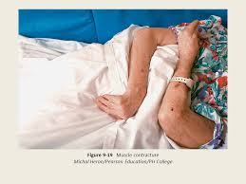
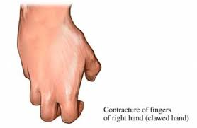
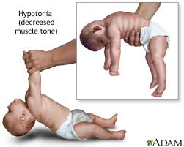
Diseases and Conditions
Contracture: tightening of skin and muscle tissue due to lack of use
Hypotonia: loss of muscle tone

Slide 12
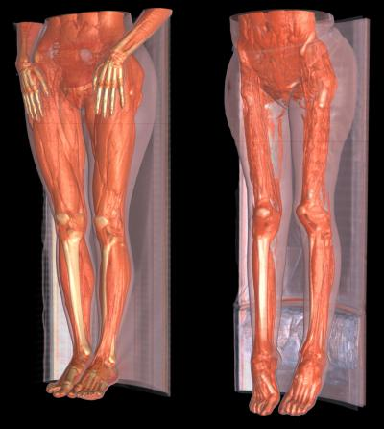
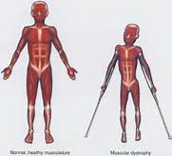
Diseases and Conditions
Muscular dystrophy: progressive weakness and deterioration of skeletal muscle
Tetany: state of sustained muscle spasm
Spasm: involuntary muscle contraction
Rigor (rigidity): muscle stiffness
Tremor: involuntary repetitive shaking

Slide 13
Therapeutic Drug Treatments
*You only need to describe the new ones in your journal
Analgesic
Antipyretic
Anti-inflammatory
Antispasmodic (anticholinergic)
Narcotic
Nonsteroidal anti-inflammatory drug (NSAID)

Slide 14
Directional Movements: define each and draw a stick figure doing each motion using arrows for directions
Elevation
Depression
Flexion
Extension
Rotation
Pronation
Supination
Circumduction
Abduction
Adduction
Inversion
Eversion
Hyperextension
Dorsiflexion
Plantar flexion

