Slide 2
Chapter 5
The Blood and the Lymphatic and Immune Systems

Slide 3
Structures and Functions of the Blood

Slide 4
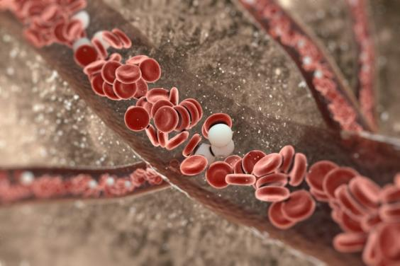
Fluid Systems of the Body
Blood—part of the circulatory or cardiovascular system
Lymph—part of the lymphatic system
vitstudio/Shutterstock.com

Slide 5
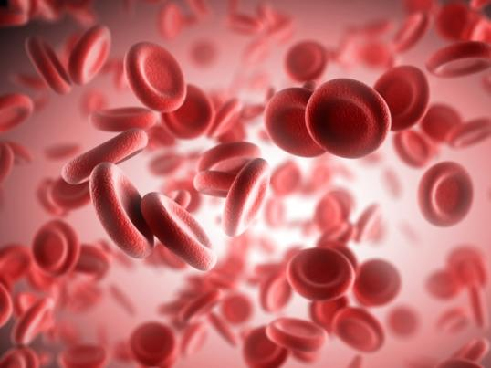
Erythrocytes
Red blood cells or RBCs
Manufactured in the bone marrow
Contain hemoglobin, that carries oxygen
Transport oxygen and carbon dioxide throughout the body
Sashkin/Shutterstock.com

Slide 6
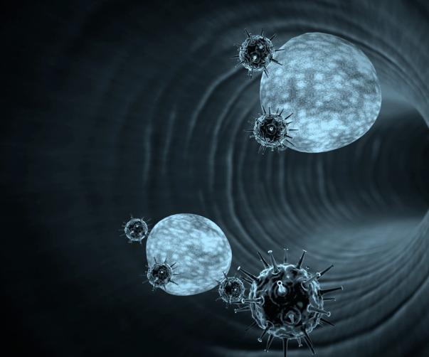
Leukocytes
White blood cells or WBCs
Fight infection
Manufactured mainly in the bone marrow
Defend the body against harmful substances
UGREEN 3S/Shutterstock.com

Slide 7
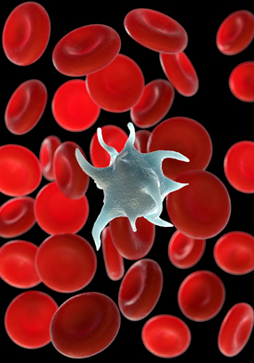
Thrombocytes
AKA Platelets
Aid in coagulation (blood clotting)
royaltystockphoto.com/Shutterstock.com

Slide 8
Plasma: liquid portion of the blood
Water
Hormones
Sugar
Salts
Waste products
Proteins

Slide 9
Remember This?
What are the two major elements of the blood?
blood cells and plasma
What is the difference between an antibody and an antigen?
An antigen is a substance that is harmful to the body
An antibody is a protein manufactured by the immune system when body detects an antigen

Slide 10
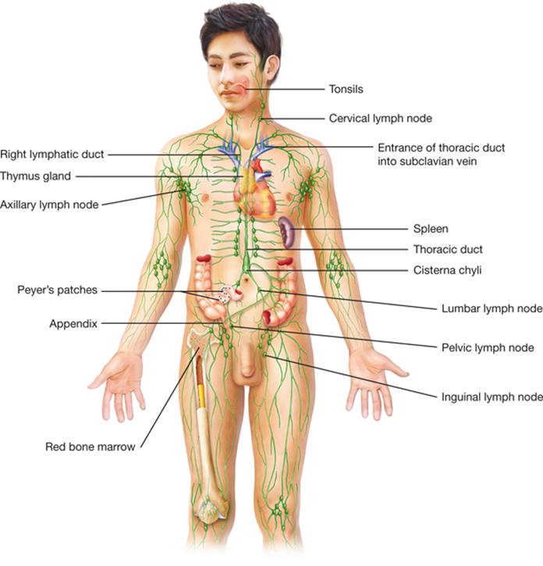
The Lymphatic System
Group of organs and structure that play a major role in the body’s immune system

Slide 11
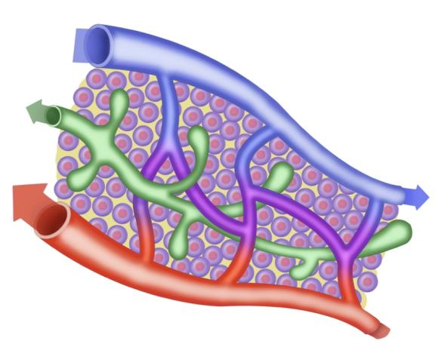
Functions of the Lymphatic System
Manufactures and transports lymph
Removes wastes, germs, toxins, and other substances from the body
Controls fluid balance
Alexilusmedical/Shutterstock.com

Slide 12
Structure of the Lymphatic System (Be able to describe each)
Lymph
Lymphatic vessels
Lymph nodes
Tonsils
Thymus
Spleen
Liver
Peyer’s patches
© Body Scientific International

Slide 13
What organ……?
Hemolysis (removing and breaking down of old red blood cells) is the main function of the ________, and is located in the LUQ.
_______are masses of lymphatic tissue in the pharynx.
The ________is part of the digestive system AND functions with the lymphatic system by filtering blood and storing healthy erythrocytes.

Slide 14
Functions of the Immune System
Protects the body from pathogens (disease)
Includes the following systems:
integumentary system
respiratory system
digestive system
lymphatic system

Slide 15
Immunity: ability to resist pathogens and toxins that cause infection/disease
Types:
Natural immunity
Acquired immunity
Structures:
T cells
B cells
*These should already be defined in your notes!

Slide 16
Classification of Diseases and Conditions: You will need to define each in your notes
Chronic
Debilitating
Acute
Autoimmune
Genetic
Congenital
Convalescence
Endemic
Epidemic
Opportunistic
Nutritional
Terminal
Nosocomial
Hypersensitivity
Iatrogenic
Idiopathic
Immunological
Infectious
Inflammatory
Ischemic
Metabolic

Slide 17
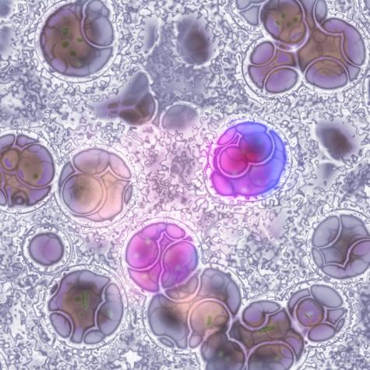
Diseases and Conditions of the Blood
Anemia (an- /-emia): excessive destruction of RBCs
Hemophilia (hem/o/-philia): longer bleeding times due to blood failing to clot normally (genetic)
Leukemia (leuk/o/-emia): blood cancer in the bone marrow causing increased WBCs
Leukemia cells
Giovanni Cancemi/Shutterstock.com

Slide 18
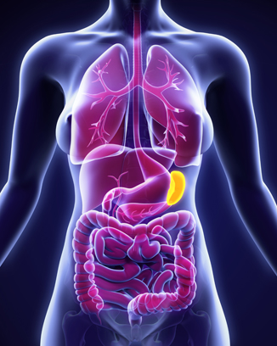
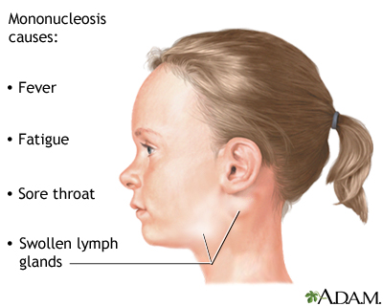
Diseases and Conditions of the Lymphatic and Immune Systems
Splenomegaly(splen/o)/-megaly): enlargement of the spleen
AIDS: suppressed immune system due to HIV (destruction of T cells)
Lymphoma: malignant cancer of the lymph nodes/tissue
Mononucleosis: (“kissing disease”) acute & infectious spread by the Epstein-Barr virus via saliva.
Allergy: hypersensitive reaction to an allergen such as animal dander, pollen, or food.
Splenomegaly
Nerthuz/Shutterstock.com

Slide 19
Diagnostic Tests and Procedures
Apheresis: separation of blood into components using a special machine
Biopsy: removal of small piece of tissue for exam
Coagulation test: measures ability of blood to clot
Complete blood count (CBC): blood test to determine number of RBCs, WBCs, and platelets
Crossmatching: uses sample of donor’s blood to check for blood type compatibility before a blood transfusion
Bone marrow transplant: replacement of diseased bone marrow with healthy donor bone marrow

Slide 20
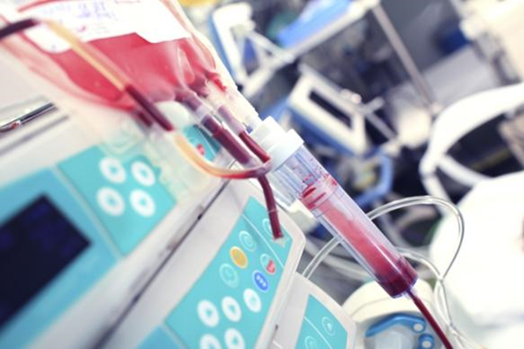
Your Turn
The victim of an auto accident is in serious condition and has lost a lot of blood. What laboratory test would the physician order to determine blood-type compatibility before giving the patient a blood transfusion?
(type and) crossmatching

Slide 21
Drug Therapies (you are responsible for the new and drugs in previous chapters)
Antineoplastic: drug that blocks the growth of a cancer
Biologic: drug that works like parts of the immune system by disrupting the immune response
Cytoxic: drug that kills or damages cells preventing them from multiplying (chemotherapy)
Immunosuppressant: reduces body’s normal reaction to invasion
sfam_photo/Shutterstock.com

Slide 22
Side Notes………(Chapter 5)
Make sure you have read and taken notes on the following areas:
Careers
Description & function of all structures/organs in these systems
Abbreviations
Disease classification vocabulary

