Slide 1
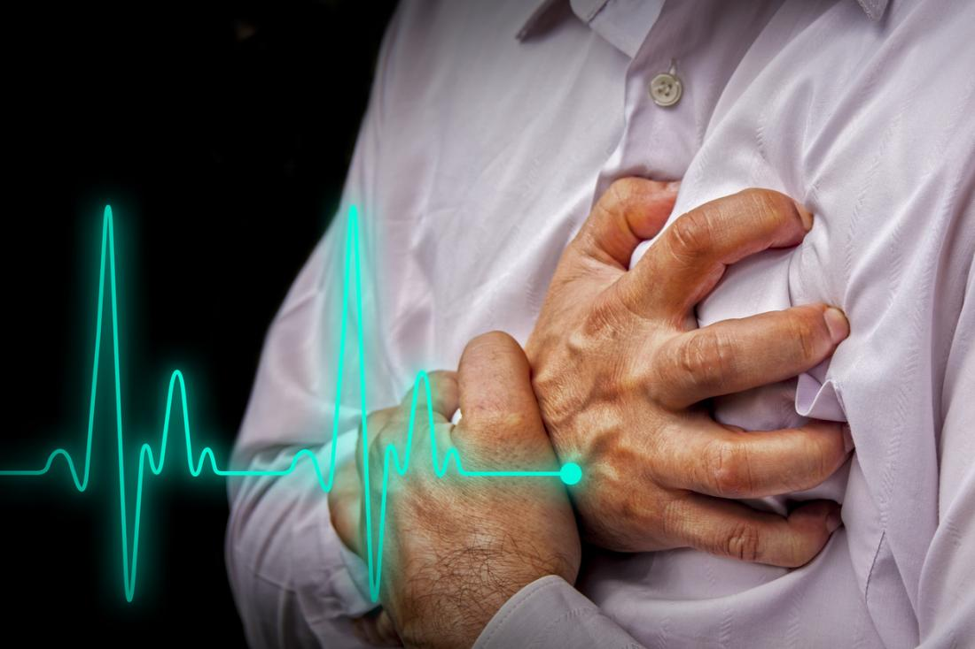
Cardiovascular System
Part 2: Diseases and Treatments

Slide 2
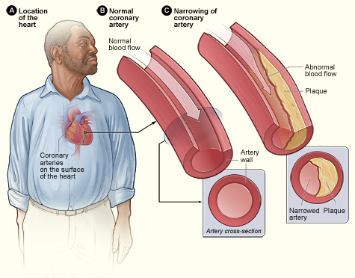
Diseases and Conditions
Aneurysm: dilated blood vessel→
Angina: spasmodic chest pain caused by ischemia
Cardiac tamponade: compression of the heart due to excess fluid in pericardium
Congestive heart failure (CHF): reduced blood flow heart
Coronary artery disease (CAD): narrowing of the coronary arteries causing ischemia to myocardium
Aneurysm
© Body Scientific International

Slide 3
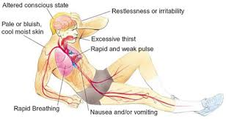
Diseases and Conditions
Atherosclerosis
Atherosclerosis: plaque build up in the arteries (plaque hardening)
Arrhythmia: irregular heart beat
Bradycardia: condition of slow heart (rate)
Tachycardia: condition of fast heart (rate)
Shock: insufficient blood flow to the heart for normal body function
© Body Scientific International

Slide 4
Diseases and Conditions
Embolus
Embolus: mass traveling in the blood vessel that causes an obstruction
Thrombus: blood clot in the wall of a blood vessel
Heart murmur: abnormal heart sound
Hypertension: condition of high (blood) pressure
Hypotension: condition of low (blood) pressure
CLIPAREA | Custom media/Shutterstock.com

Slide 5
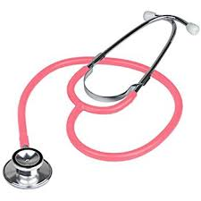
Diagnostic Tests and Procedures
Angiogram: uses a contrast dye to with a camera to monitor blood flow in vessels
Cardiac catheterization: placement of small catheter into artery to diagnose heart diseases
Auscultation: using a stethoscope to listen to internal body sounds (heart, lungs, & bowels)
Cardiac catheterization
© Body Scientific International

Slide 6
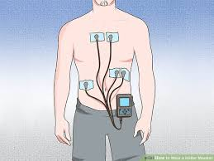
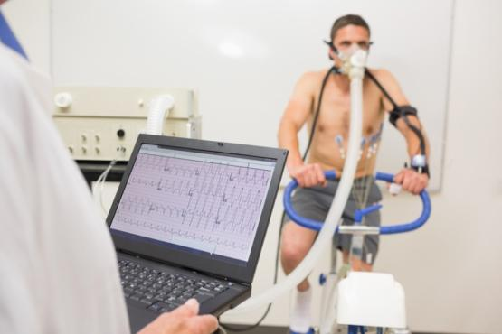
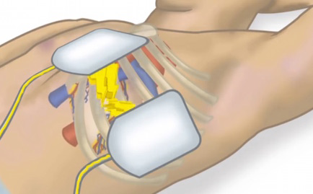
Diagnostic Tests and Procedures
Holter monitor: portable machine worn to record cardiac rhythms
Stress test: procedure that tests how well heart is pumping
Cardioversion: use of controlled electrical shock sent to the heart to restore a normal heart rhythm
planned procedure
Defibrillation: uses an electrical shock to stop fibrillation of the heart in an emergency
wavebreakmedia/Shutterstock.com

Slide 7
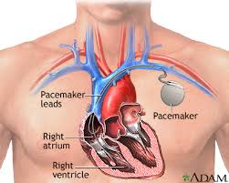
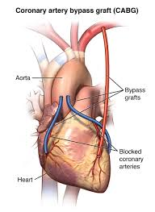
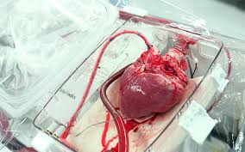
Surgical Procedures and Therapeutics
Pacemaker: electrical device implanted to stimulate the heart
Coronary artery bypass graft (CABG)
Heart transplant: grafting a healthy donor heart to a patient
© Body Scientific International

Slide 8
Therapeutic Drug Treatments
Angiotensin-converting (ACE) inhibitor: used to treat hypertension
Antianginal: used to prevent or alleviate spasmodic chest pain (angina)
Anticoagulant: prevents blood clots
Antihypertensive: counter acts high BP
Antiarrhythmic: prevents or alleviates abnormal heart rhythms (arrhythmias)
Beta blocker: used to treat angina, hypertension, heart rhythm disorders, migranes, tremors and panic attacks
Oleksii Fedorenko/Shutterstock.com

Slide 9
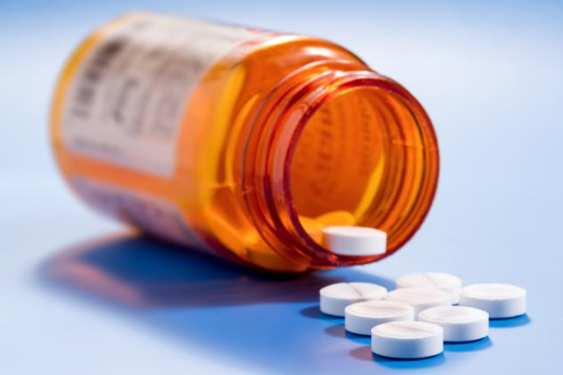
Therapeutic Drug Treatments
Calcium channel blocker: dilates arteries and reduces BP so the heart can pump easier
Diuretic: reduces excess water in body
Hypolipidemic: reduces fats/cholesterol in the blood
Thrombolytic: dissolve/breakdown clots
Vasoconstrictor: narrows blood vessels to increase BP
Vasodilator: widens blood vessels to decrease BP
science photo/Shutterstock.com

