Slide 2
CARDIOVASCULAR (Circulatory) SYSTEM

Slide 3
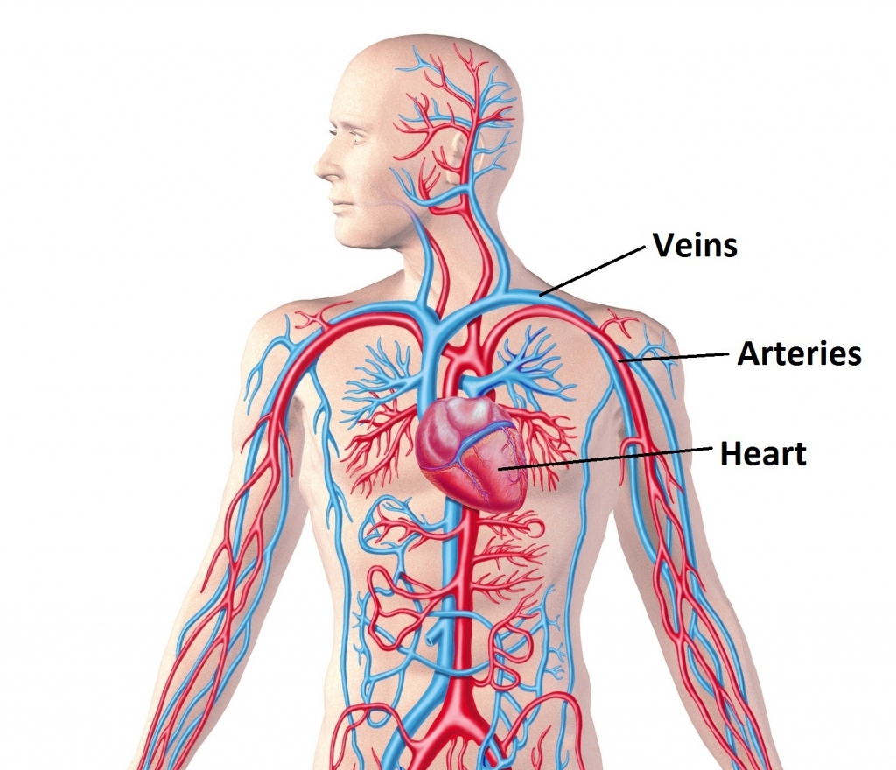
Cardiovascular Anatomy

Slide 4
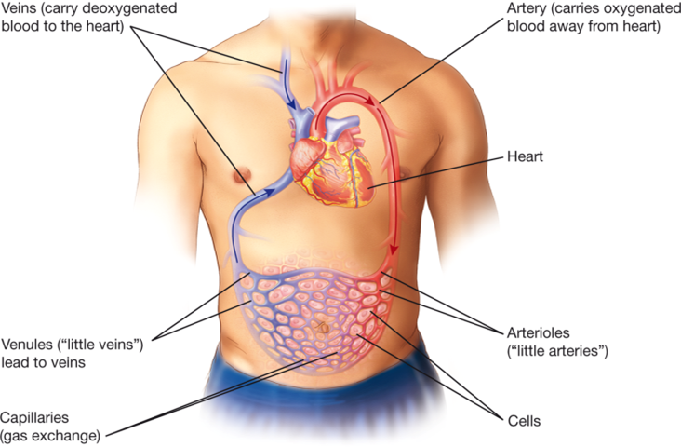
FUNCTION
The cardiovascular system is the body’s “delivery” system
It circulates blood throughout the body
Carries waste in the blood to be removed by other systems

Slide 5
STRUCTURES
Heart: 4-chambered muscular pump that circulates blood throughout the body
Blood: circulates nutrients, oxygen to all parts of the body and transports waste products
Blood Vessels:
Arteries: carry blood away from the heart
Veins: carry blood to the heart

Slide 6
The Heart
Layers
Epicardium—innermost layer of pericardium
(pericardium is the layer that surrounds the heart)
Myocardium—middle muscular layer
Endocardium—lines inner chambers and covers valves
Chambers
Atria—receive blood from veins (upper chambers)
Ventricles—pump blood to lungs and rest of body (lower chambers)
(Continued)

Slide 7
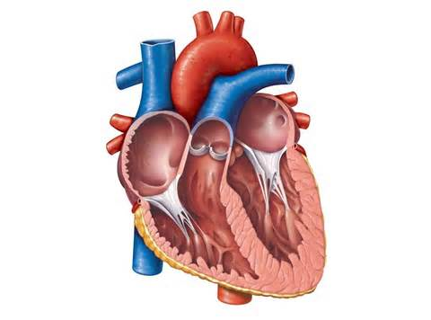
Layers of the Heart
Myocardium: muscular “middle” layer of heart
Pericardium: layer around the heart (epicardium)
Endocardium: layer inside heart
C
B
A

Slide 8
The Heart Valves
Atrioventricular (AV) valves
Tricuspid (between right atrium & right ventricle)
Bicuspid or mitral (between left atrium and left ventricle)
Semilunar valves
Pulmonary (pulmonary artery)
Aortic (aortic artery)
© Body Scientific International

Slide 9
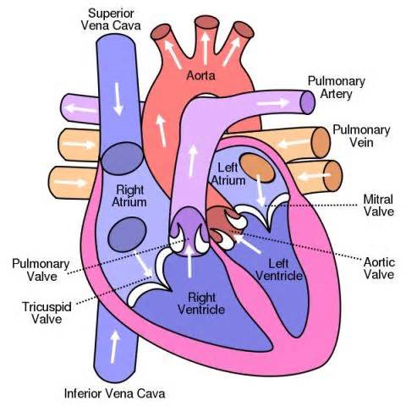
Parts of the Heart

Slide 10
Circulation
Pulmonary circulation
Right side of heart
From heart to lungs and back to heart
Systemic circulation
Left side of heart
From heart to body cells and back to heart
© Body Scientific International

Slide 11
Blood Flow Through the Heart
Oxygen-poor blood
Vena Cava
Right Atrium
Tricuspid Valve
Right Ventricle
Pulmonary valve
Pulmonary artery
Lungs
Pulmonary Veins
Left Atrium
Bicuspid/Mitral Valve
Left Ventricle
Aortic Valve
Aorta
Oxygen-rich blood
1
15

Slide 12
Video Links: Blood Flow
https://www.youtube.com/watch?v=BEWjOCVEN7M
https://www.youtube.com/watch?v=UMTDmP81mG4

Slide 13
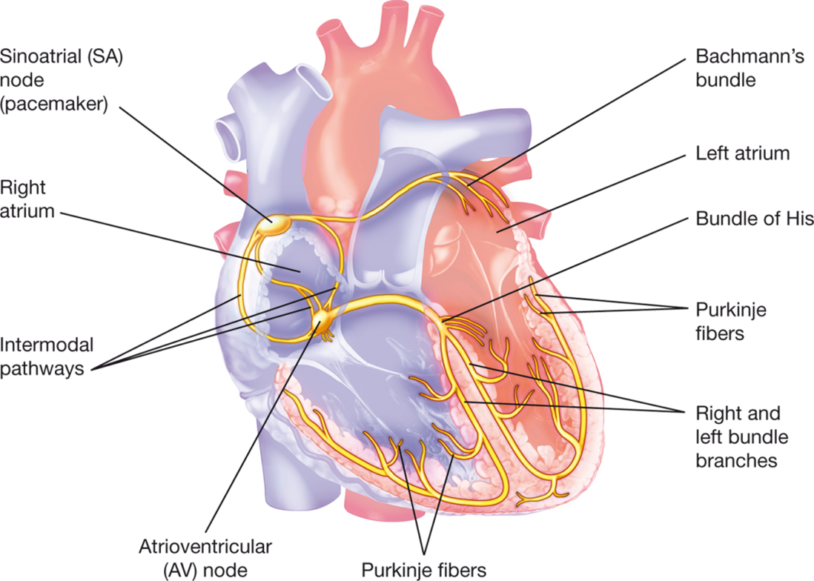
Conduction: electric current in the heart that causes the myocardium to contract
The average adult heart rate is 60-90 bpm (beats per minute)
SA (sinoatrial)node is the pacemaker of the heart
Systole: contraction of the ventricles
Diastole: relaxation of the ventricles

Slide 14
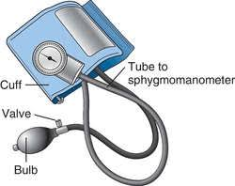
Blood Pressure: pressure exerted by the blood against the wall of an artery/vein
Written as a ratio
Systolic BP-ventricles contracting
Diastolic BP- ventricles relaxing
Normal adult BP is systolic= 90-140/diastolic= 60-90
BP is measured in mm/Hg
Sphygmomanometer=blood pressure cuff & gauge

Slide 15
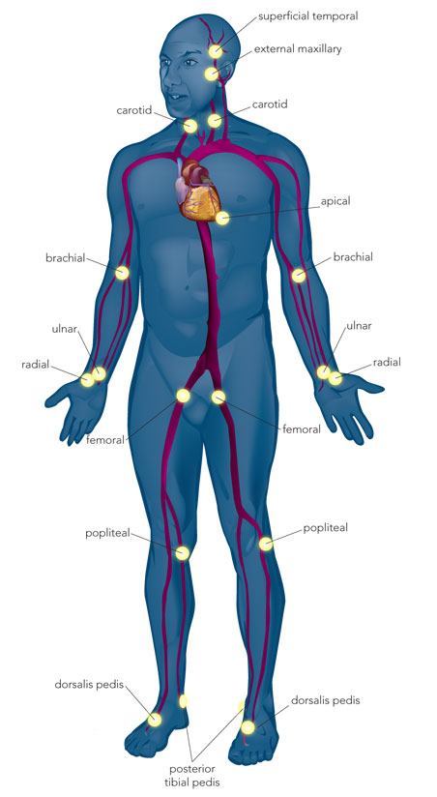
PULSE POINTS
Pulse: throbbing of arteries generated by heart contractions
Radial is the most common pulse point
Apical must be taken with a stethoscope
Brachial is used to take blood pressure

Slide 16
Flipped Classroom: define/describe the following (in journal) using your textbook
Aneurysm
Angina
Cardiac Tamponade
Congestive Heart Failure
Coronary Artery Disease
Atherosclerosis
Arrhythmia
Bradycardia
Tachycardia
Shock
Embolus
Thrombus
Heart murmur
Auscultation
Hypertension
Hypotension
Angiogram
Cardiac Catherization
Holter monitor
Stress test
Cardioversion
Defibrillation
Pacemaker
Coronary Artery Bypass Graft
Heart Transplant

Slide 17
Let’s Review…….

Slide 18
Remember This?
Identify each layer of the heart, including the pericardium.
Endocardium
Pericardium
Epicardium
Myocardium
© Body Scientific International

Slide 19
Blood Flow Through the Heart
Instructions
List the structures blood passes through in the heart in your journal
Hint: #1 &15 are “blood” but describe the blood in your answer
1
15

Slide 20
Blood Flow Through the Heart
Oxygen-poor blood
Vena Cava
Right Atrium
Tricuspid Valve
Right Ventricle
Pulmonary valve
Pulmonary artery
Lungs
Pulmonary Veins
Left Atrium
Bicuspid/Mitral Valve
Left Ventricle
Aortic Valve
Aorta
Oxygen-rich blood
1
15

Slide 21
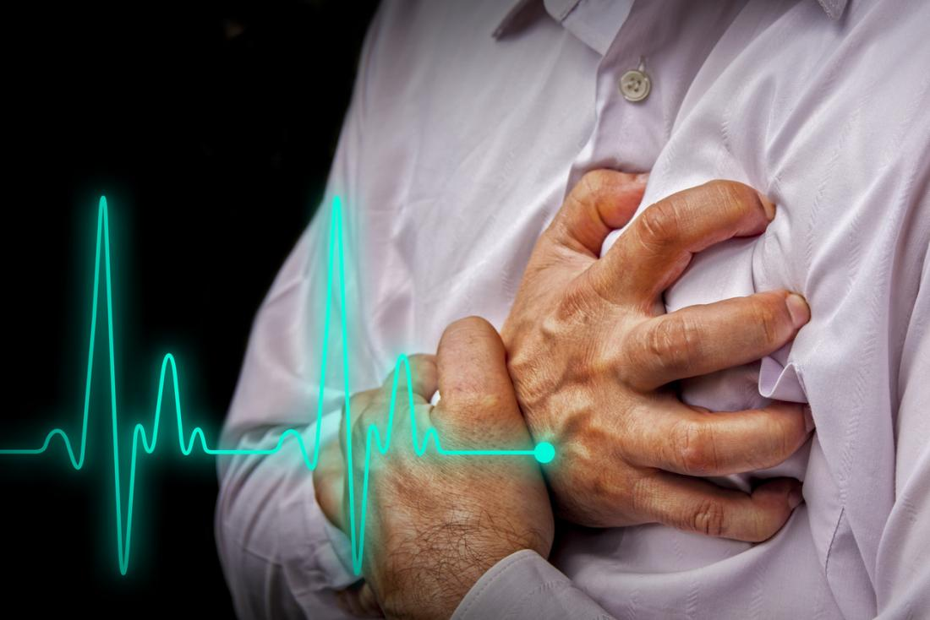
Cardiovascular System
Part 2: Diseases and Treatments

Slide 22
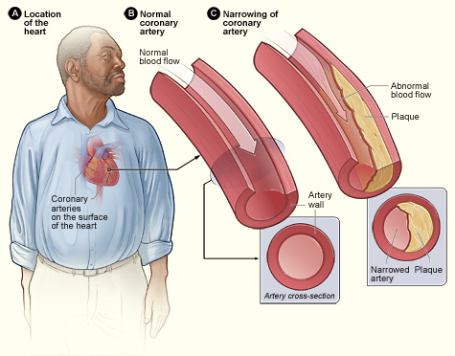
Diseases and Conditions
Aneurysm: dilated blood vessel→
Angina: spasmodic chest pain caused by ischemia
Cardiac tamponade: compression of the heart due to excess fluid in pericardium
Congestive heart failure (CHF): reduced blood flow heart
Coronary artery disease (CAD): narrowing of the coronary arteries causing ischemia to myocardium
Aneurysm
© Body Scientific International

Slide 23
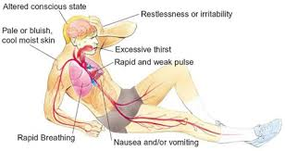
Diseases and Conditions
Atherosclerosis
Atherosclerosis: plaque build up in the arteries (plaque hardening)
Arrhythmia: irregular heart beat
Bradycardia: condition of slow heart (rate)
Tachycardia: condition of fast heart (rate)
Shock: insufficient blood flow to the heart for normal body function
Myocardial Infarction (MI): tissue death of heart muscle (heart attack)
© Body Scientific International

Slide 24
Diseases and Conditions
Embolus
Embolus: mass traveling in the blood vessel that causes an obstruction
Thrombus: blood clot in the wall of a blood vessel
Heart murmur: abnormal heart sound
Hypertension: condition of high (blood) pressure
Hypotension: condition of low (blood) pressure
CLIPAREA | Custom media/Shutterstock.com

Slide 25
Diagnostic Tests and Procedures
Angiogram: uses a contrast dye to with a camera to monitor blood flow in vessels
Cardiac catheterization: placement of small catheter into artery to diagnose heart diseases
Auscultation: using a stethoscope to listen to internal body sounds (heart, lungs, & bowels)
Cardiac catheterization
© Body Scientific International

Slide 26
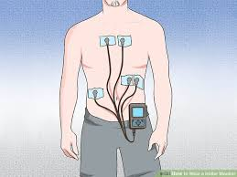
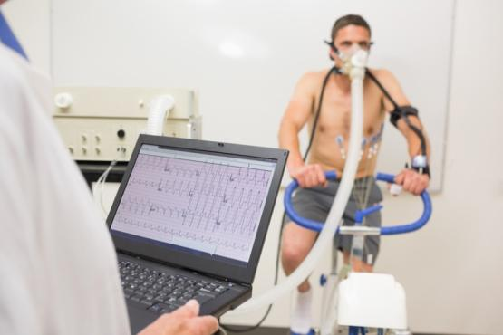
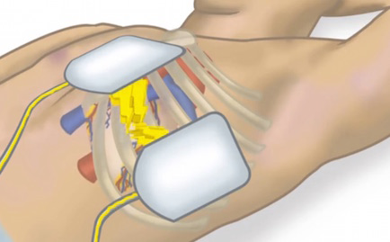
Diagnostic Tests and Procedures
Holter monitor: portable machine worn to record cardiac rhythms
Stress test: procedure that tests how well heart is pumping
Cardioversion: use of controlled electrical shock sent to the heart to restore a normal heart rhythm
planned procedure
Defibrillation: uses an electrical shock to stop fibrillation of the heart in an emergency
wavebreakmedia/Shutterstock.com

Slide 27
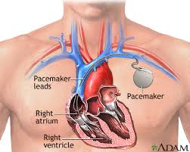
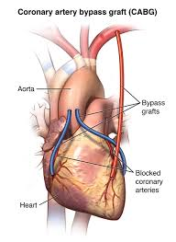
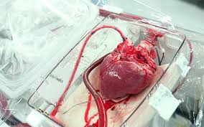
Surgical Procedures and Therapeutics
Pacemaker: electrical device implanted to stimulate the heart
Coronary artery bypass graft (CABG)
Heart transplant: grafting a healthy donor heart to a patient
© Body Scientific International

Slide 28
Therapeutic Drug Treatments
Angiotensin-converting (ACE) inhibitor: used to treat hypertension
Antianginal: used to prevent or alleviate spasmodic chest pain (angina)
Anticoagulant: prevents blood clots
Antihypertensive: counter acts high BP
Antiarrhythmic: prevents or alleviates abnormal heart rhythms (arrhythmias)
Beta blocker: used to treat angina, hypertension, heart rhythm disorders, migranes, tremors and panic attacks
Oleksii Fedorenko/Shutterstock.com

Slide 29
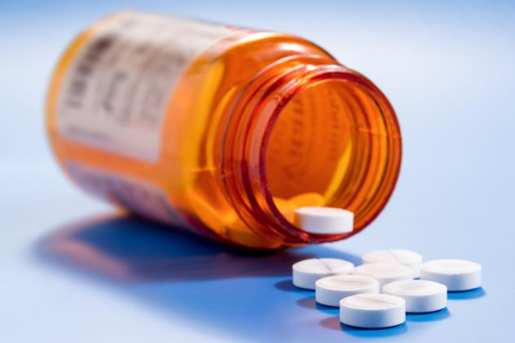
Therapeutic Drug Treatments
Calcium channel blocker: dilates arteries and reduces BP so the heart can pump easier
Diuretic: reduces excess water in body
Hypolipidemic: reduces fats/cholesterol in the blood
Thrombolytic: dissolve/breakdown clots
Vasoconstrictor: narrows blood vessels to increase BP
Vasodilator: widens blood vessels to decrease BP
science photo/Shutterstock.com

Slide 30
Practice slides……

Slide 31
Your Turn….Abbreviations
Identify the meanings of the following common medical abbreviations:
BP
blood pressure
CABG
coronary artery bypass graft
VSD
ventricular septal defect

Slide 32
Your Turn…practice
Define each type of drug and identify the meanings of its word parts:
antianginal
anti- = against; angina = chest pain; -al = pertaining to definition: medication to alleviate angina
vasoconstrictor
vas/o = vessel; constrict/o = narrowing; -or = something that does something
definition: medication that restricts blood vessels

