Slide 1
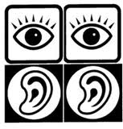
Chapter 10
Special Senses

Slide 2
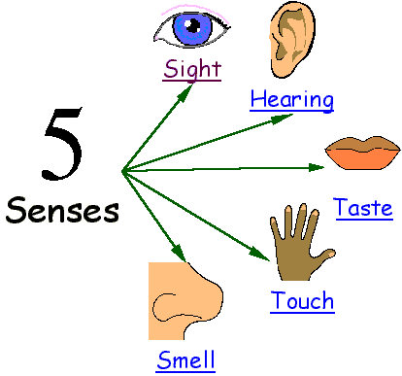
Sensory Organs and Receptors
Primary Functions
Receive external stimulation and transmit these stimuli to the sensory neurons.
Eyes (sight)
Ears (hearing)
Nose (smell)
Skin (touch)
Tongue (taste)

Slide 3
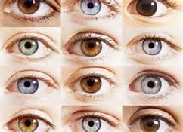
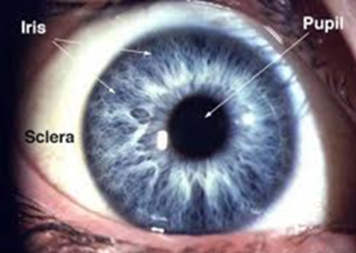
Eyes (Vision)
Primary Function
Receptor organs for the sense of sight
Anatomy
Conjunctiva: clear membrane that lines the anterior eyeball and eyelids
Sclera: white part of the eye that maintains the eye shape and protects the inner tissues
Cornea: transparent layer over the iris & pupil
Choroid: blood-rich layer under the sclera
Pupil: black circular opening that allows light in
Iris: colored muscular layer that surrounds the pupil

Slide 4
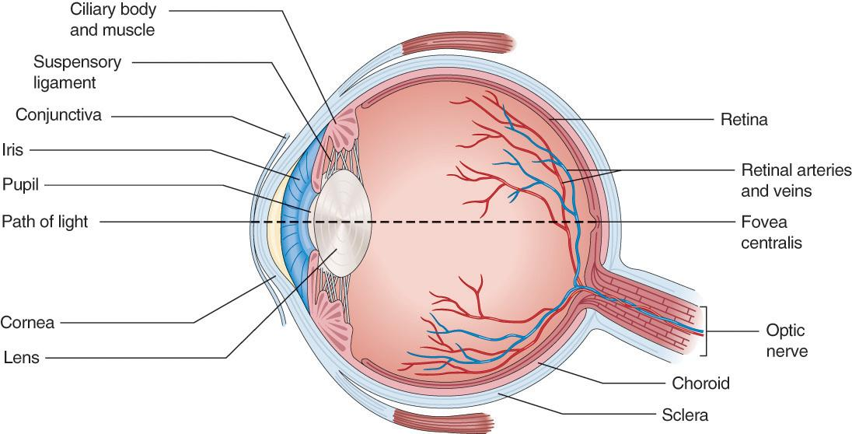
Anatomy of the Eye
Ciliary body: muscles and ligaments that adjust the eye shape for focusing on objects
Aqueous humor: anterior chamber fluid that gives the eyeball shape & provides nutrients to lens and cornea

Slide 5
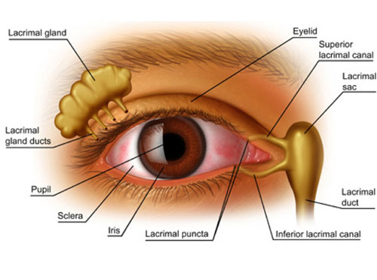
Anatomy of the Eye
Fovea Centralis: area of sharpest visual acuity
Lacrimal Apparatus (tear apparatus):
Lacrimal glands: secrete tears
Ciliary glands: tiny sweat glands that secrete a protective lubricant onto the eyeball
Lacrimal canaliculi: ducts on the inner corner of the eyes that collect tears and drain them
Lacrimal sac: (tear sac) stores tears before they are drained by the lacrimal duct
Lacrimal duct: passageway that drains tears into the nose

Slide 6
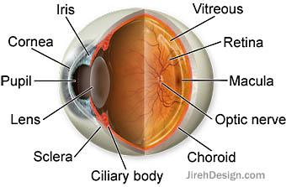
Anatomy of the Eyeball
Vitreous Humor: clear gel-like fluid in posterior chamber of the eyeball that keeps retina in place
Retina: thin layer of tissue in posterior eye that converts light to neural signals as vision
Photoreceptors: light sensitive cells that receive images and convert them to nerve impulses
Rods: allow us to see in dim vision (black & white receptors)
Cones: color receptors
Macula: area with large amount of cones for high acuity vision
Optic Nerve (2nd cranial nerve): transports impulses from retina to brain
Optic disk: blind spot

Slide 7
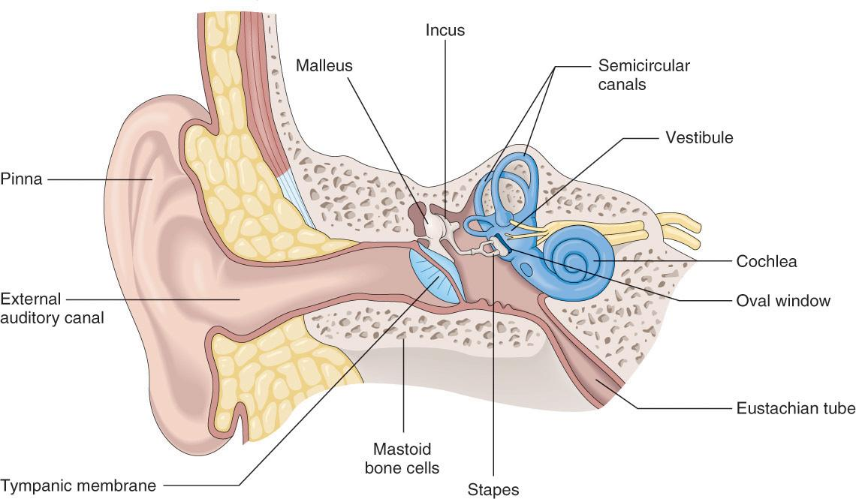
Structures of the Ear
Primary Functions of the Ear
Receptor organs for the sense of hearing.
Help to maintain balance.

Slide 8
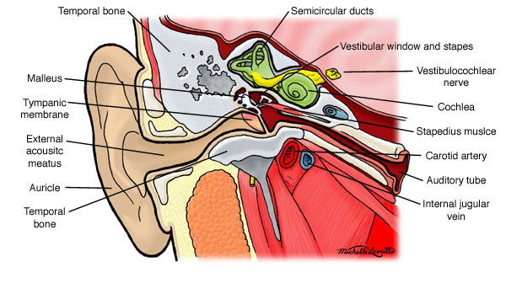
Ears (Hearing and Sound)
Functions of the three areas of the ear:
Outer (External): hearing
Middle (Tympanic Cavity): hearing
Inner (Internal): hearing and equilibrium

Slide 9
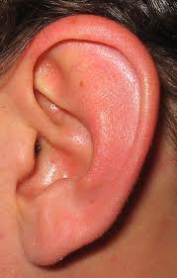
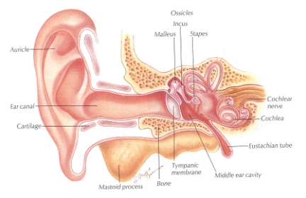
Outer Ear
Primary Function
Transmits sound waves to the middle ear.
Primary Structures
Auricle (Pinna): shell-shaped structure of outer ear
Auditory Canal (External acoustic meatus): canal that leads to tympanic membrane
Cerumen: earwax

Slide 10
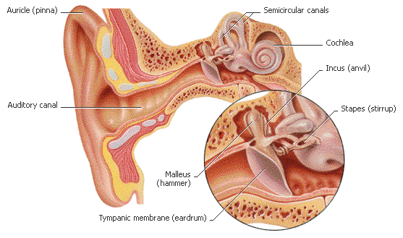
Middle Ear (Tympanic Cavity)
Auditory Ossicles:
3 small bones in the tympanic cavity
Malleus (hammer)
Incus (anvil)
Stapes (stirrup)
*These bones together transmit vibrations of the eardrum to the fluids of the inner ear
Tympanic membrane: (eardrum)transmits sound via waves of vibration

Slide 11
Middle Ear (Tympanic Cavity)
Eustacian Tubes: (auditory tube) that equalizes pressure
Labrinth: contains structures that control balance
Vestibulocochlear nerve: auditory nerve
Coclea: snail like structure that contains fluids that carry sound vibrations

Slide 12
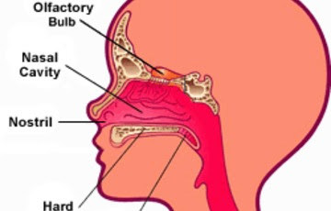
Nose (Smell)
Humans sense of smell is inferior to other animals.
Olfactory Nerve: first cranial nerve
Olfactory Receptor Cells: react to odors

Slide 13
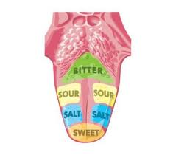
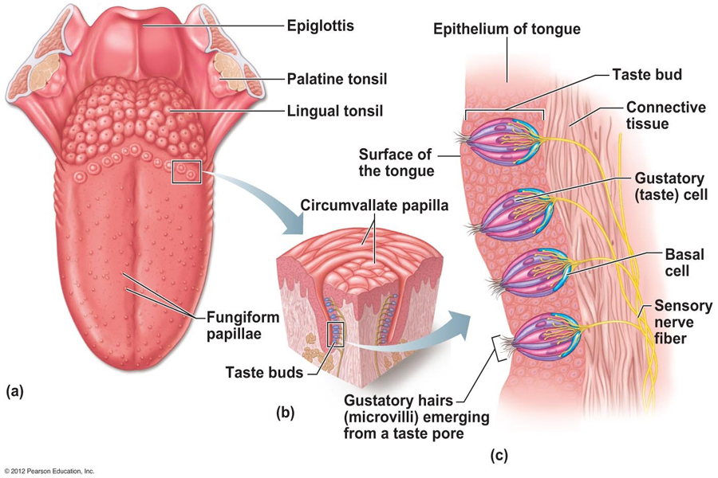
Tongue (taste)
Functions include deglutination, gustatory sense (taste), & mastication
Anatomy
Papillae: raised areas that contain taste buds
Taste buds: tiny areas that distinguish different tastes
How many taste buds are you born with?

Slide 14
Skin: sense of touch, pain, pressure, & temperature
Touch receptors: epidermis
Pressure receptors: deeper in dermis
Pain receptors: located beneath epidermis near hair follicles
*Skin on hands, lips, and fingertips are the MOST sensitive areas

Slide 15
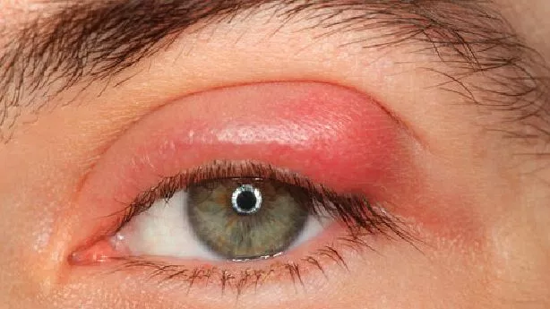
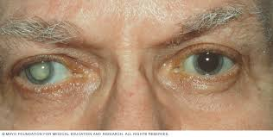
Name the Eye Condition

Slide 16
Eye: Disorders
Refractive Disorders:
Astigmatism: abnormal curvature of the cornea
Hyperopia: farsightness (up close images appear blurry)
Myopia: (nearsightedness) distant images appear blurry
Presbyopia: farsightedness caused by decreased elasticity in the lens from aging

Slide 17
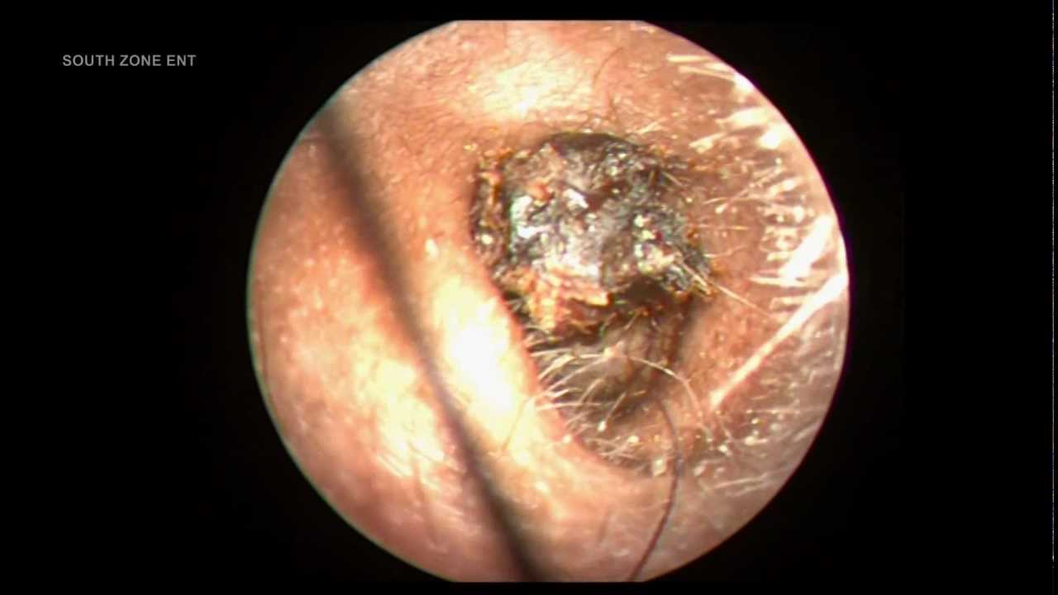
Disorders of the Ear
Conductive deafness: inadequate sound-wave conduction
Nerve deafness: results from damage to cochlea or auditory nerve (sensorineural hearing loss)
Impacted Cerumen: heavy accumulation of earwax that could lead to infection or hearing loss
Meniere’s Disease: inner ear disturbance causing dizziness and spinning (vertigo)
Tinnitus: ringing in the ears

Slide 18
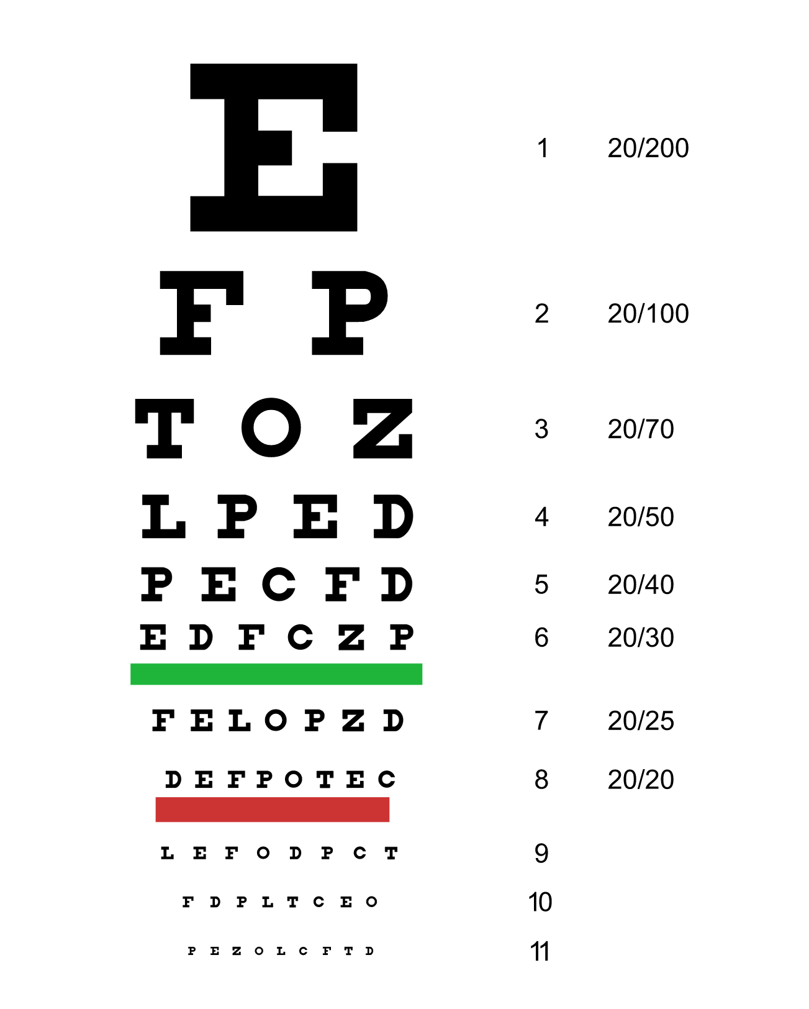
Diagnostic Tests & Procedures
Ishihara Color Vision Test: detects color blindness
Visual Acuity Test: uses a Snellen chart to detect myopia and hyperopia
Visual Field Test: measurement of what can be seen in a certain area when eyes are looking straight ahead without moving head

Slide 19
Diagnostic Tests & Procedures
Audiometry: testing to measure the ability to hear different sounds (process of measuring hearing)
LASIK: (laser in situ keratotomy) uses UV laser to correct refractive conditions
Enucleation: surgical removal of eyeball
Phacoemulsification: lens is broken up with ultrasonic vibrations then suctioned out (usually due to cataracts and to prepare for an artificial lens)

Slide 20
Diagnostic Tests & Procedures
Precision Nerve Exams: tests for 5 different responses to evaluate the nervous system for a disorder
Extinction: touch of different areas and patient has to identify sites with eyes closed.
Graphesthesia: pt must identify letter/number written on hand (eyes closed)
Pain & light-touch sensation: identifying sharp or dull objects placed upon skin while eyes closed lying supine
Position sense: identify if big toe moved up or down
Stereognosis: pt has to identify object placed in hand with eyes closed.

