Slide 1
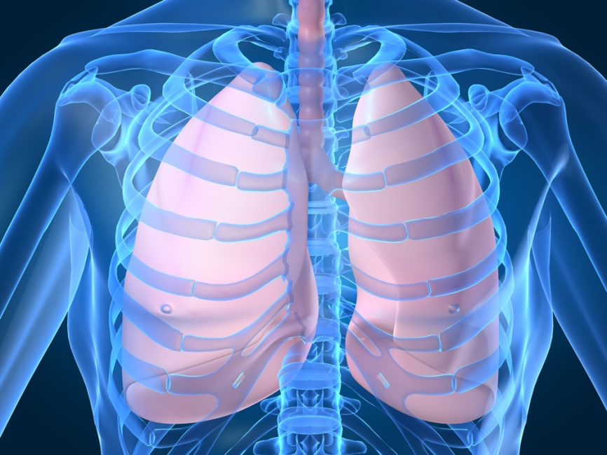
The Respiratory System Anatomy & Function
https://www.youtube.com/watch?v=zd_e9gtDExM

Slide 2
Additional Terminology
-oxia: oxygen
ENT: ear, nose, throat
RLL: right lower lobe
LLL: left lower lobe
RUL: right upper lobe
LUL: left upper lobe

Slide 3
Function
Provide body with oxygen & eliminate carbon dioxide (exchange of O2 & CO2)
Pass air over vocal cords to produce sound

Slide 4
Structures of the Respiratory System

Slide 5
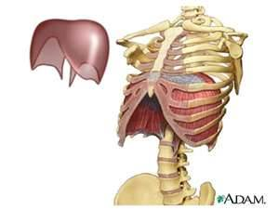
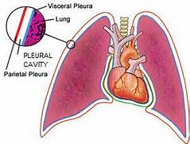

Slide 6
Respiratory Structures
Mouth/Nose: air enters the body (warms and filters the air)
Pharynx: throat (only structure that takes in air, food, and liquid)
Larynx: voice box
Trachea: wind pipe (delivers air to the bronchi)
Epiglottis: leaf-like structure that covers the larynx to keep food from entering into the trachea

Slide 7
Respiratory Structures
Bronchi: 2 tubes that carry air from the trachea to the lungs (singular=bronchus)
Lungs: 2 spongy organs located in the thoracic cavity that add oxygen to the blood
Alveoli: tiny air sacs in the lungs that allow the exchange of oxygen and carbon dioxide
Diaphragm: muscle that separates the thoracic and abdominal cavities and aids in breathing

Slide 8
Pathway of Air
Nose/Mouth
Nasal/Oral Cavities
Pharynx
Larynx
Trachea
Bronchi
Lungs →bronchioles→alveoli
Oxygen to blood

Slide 9
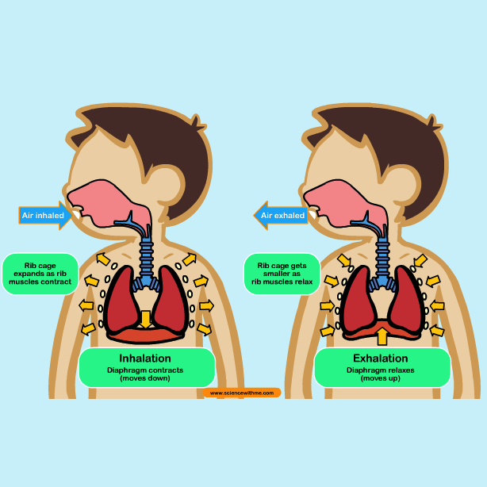
The Process of Breathing
Inspiration (Inhalation): breathing in
Expiration (Exhalation): breathing out
Respiration: exchange of oxygen and carbon dioxide
Ventilation: process of moving air in and out of the lungs (a breath in and a breath out)

Slide 11
Group Practice
Define:
rhinoplasty
pulmonologist
apnea
pneumocentesis
laryngitis
*List the pathway of air into the body:

Slide 12
KEY
Surgical repair of the nose
Lung specialist
Without breathing
(surgical) puncture of lung/air
Inflammation of the voicebox

Slide 13
Review
Correctly spell:
Surgical removal of nose
Slow breathing
Excessive oxygen
Windpipe inflammation
Artificial opening of the windpipe
Unabbreviate:
ENT
ABG
CPR
CXR
RLL
Place the following structures in the order air passes through the respiratory system:
trachea
Larynx
Nasal/Oral cavities
Alveoli
Nose/Mouth
Lungs
Pharynx
Bronchi

Slide 14
Review Key
rhinectomy
bradypnea
hyperoxia
tracheitis
tracheostomy
ear, nose, throat
arterial blood gas
cardiopulmonary resuscitation
chest xray
right lower lobe
nose/mouth
nasal/oral cavities
pharynx
larynx
trachea
bronchi
lungs
alveoli

Slide 15
Flipped Classroom: define/describe each of the disease & conditions
Cheyne-Stokes respiration
Hyperventilation
Orthopnea
Rales
Rhonchi
Stridor
Aspiration
Asthma
Croup
COPD
Sputum
Nasopharyngitis
Cystic Fibrosis
Emphysema
Hemothorax
Pneumothorax
Influenza
Pleural Effusion
Pneumonia
Pulmonary Embolism
Sleep Apnea
TB

Slide 16
Abnormal Breath Sounds https://www.practicalclinicalskills.com/breath-sounds-reference-guide

