Slide 1
The Respiratory system
Diseases, conditions, procedures, & Treatments

Slide 2
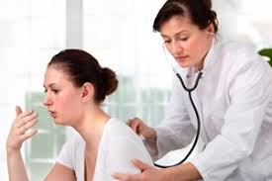
Respiratory lung Sounds
Rales: crackling sound heard during auscultation of the lungs. Indicates presence of fluid/mucus in the airway.
Rhonchi: coarse rattle, snore, or gurgling, wheezing sound heard over the bronchi. Usually clears after coughing.
Stridor: high-pitched, crowing sound during respiration that indicates airway obstruction including foreign body.
Wheeze: whistling musical sound that occurs from inflamed airways of the bronchial tree that are common in asthma.
Abnormal Breath Sounds https://www.practicalclinicalskills.com/breath-sounds-reference-guide

Slide 3
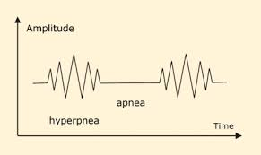
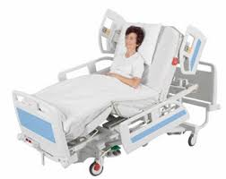
Respiratory conditions & Diseases
Cheyne-Stokes Respiration: unusual breathing pattern alternating periods of apnea then progressively faster respirations. Often called the “death rattle” as it is seen in dying patients.
Hyperventilation: condition in which breathing is faster than normal. Can be caused by stress/anxiety.
Orthopnea: breathing is easier when sitting up straight (because the person has dyspnea when lying flat). Often caused by CHF.

Slide 4
Respiratory conditions & Diseases
Aspiration: drawing in of a foreign object during inhalation through, nose, throat, or lungs
Sputum: mucus coughed up from the respiratory system
Sleep apnea: periods of cessation of breathing during sleep
Pleural effusion: leakage of fluid into the pleural cavity

Slide 5
Respiratory Conditions & diseases
COPD: (Chronic obstructive pulmonary disease) reduced ability of lungs to perform ventilation. Usually caused by smoking. Symptoms included chronic cough and dyspnea.
-Emphysema: SOB and impaired heart function due to damaged alveoli
-Chronic Bronchitis: prolonged inflammation of the bronchial tubes and their mucous membranes

Slide 7
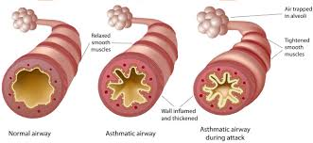
Respiratory diseases & conditions
Common cold: inflammation of the respiratory mucous membranes (can also be called nasopharyngitis or rhinopharyngitis)
Croup: childhood viral infection characterized by “barking” cough
Asthma: often caused by an allergen causes swelling of the airways and spasm of the bronchial tubes characterized by wheezing and dyspnea

Slide 8
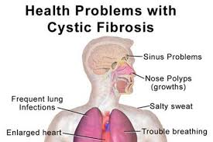
Respiratory Conditions & Diseases
Influenza: acute, contagious viral respiratory infection. S/S include fever, chills, headache, cough, myalgia, and sore throat
Pneumonia: inflammation in the lungs due to infection or irritant
Cystic Fibrosis: inherited disease that causes chronic respiratory infections with excessive mucus in the lungs, sweating, and impairment of the digestive system

Slide 9
Respiratory Conditions & Diseases

Slide 10
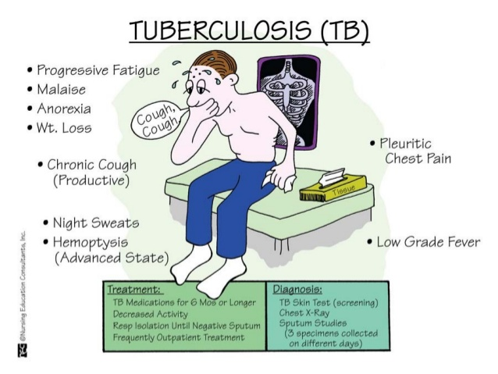
Respiratory Conditions & Diseases
Pulmonary Embolism: (PE) blood clot in the lung
Tuberculosis (TB): contagious bacterial infection in the lungs with abscesses and scarring. Spread through coughing and can cause complications with other body systems

