Slide 1
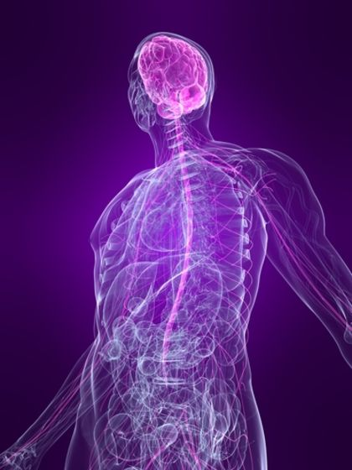
https://www.youtube.com/watch?v=uaAwIN1gPm4 https://www.youtube.com/watch?v=kMKc8nfPATI
The Nervous System
The “control center” of the body
https://www.youtube.com/watch?v=EeE7Fpg061I

Slide 2
Function of the Nervous System
Sensory Input: any electrical impulse sent from the eyes, ears, nose, tongue or skin to the central nervous system (brain and spinal cord)
Integration: information from the sensory organs is interpreted
Motor Output: the response generated from the interpretation of sensory input. Occurs in two ways:
Voluntary movement (skeletal muscle)
Involuntary movement (cardiac & smooth muscle)

Slide 3
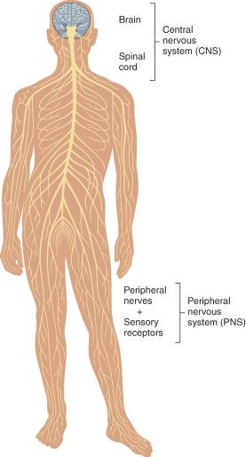
Central and Peripheral
Nervous Systems

Slide 4
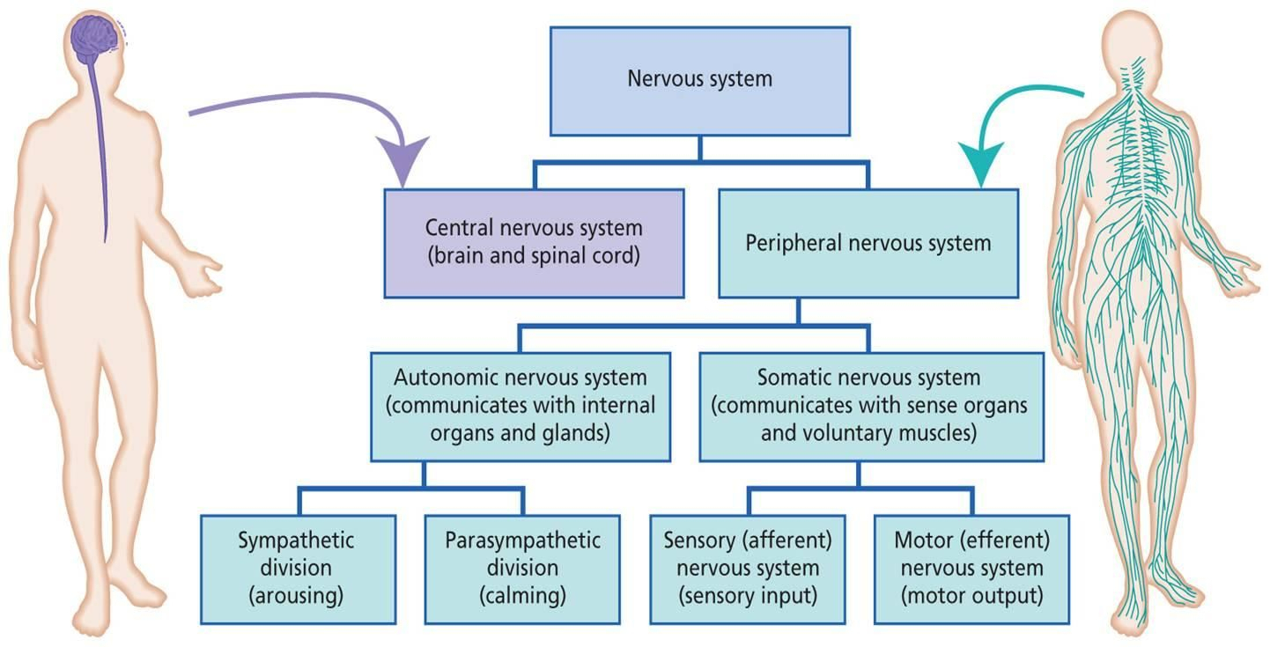
CNS vs PNS

Slide 5
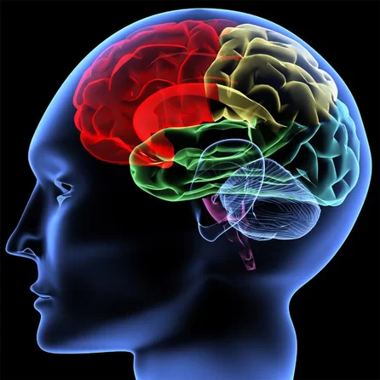
CNS: The Brain
Primary Functions
Coordinates all activities of the body by receiving and transmitting messages throughout the body.
CSF protects the brain and fills the ventricles (cavities in the brain)
Right side: controls left side of body, music/art (creativity) ,intuition, emotions, face recognition, subjectivity
Left side: controls right side of body, numbers/math/scientific skills, language, logic/reasoning, objectivity

Slide 6
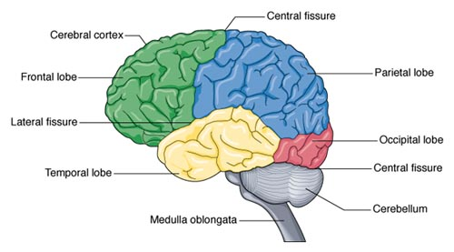
Lobes of the Brain
Occipital
Eyesight/vision
Temporal
Smell and hearing
Language
Factual & visual memory
Frontal
Controls movement
Personality & emotion
Problem-solving
Speech
Parietal
Receives and interprets sensory impulses to touch, pain, pressure, and temperature

Slide 7
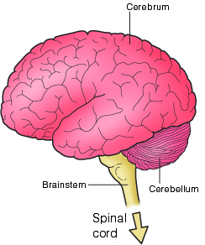
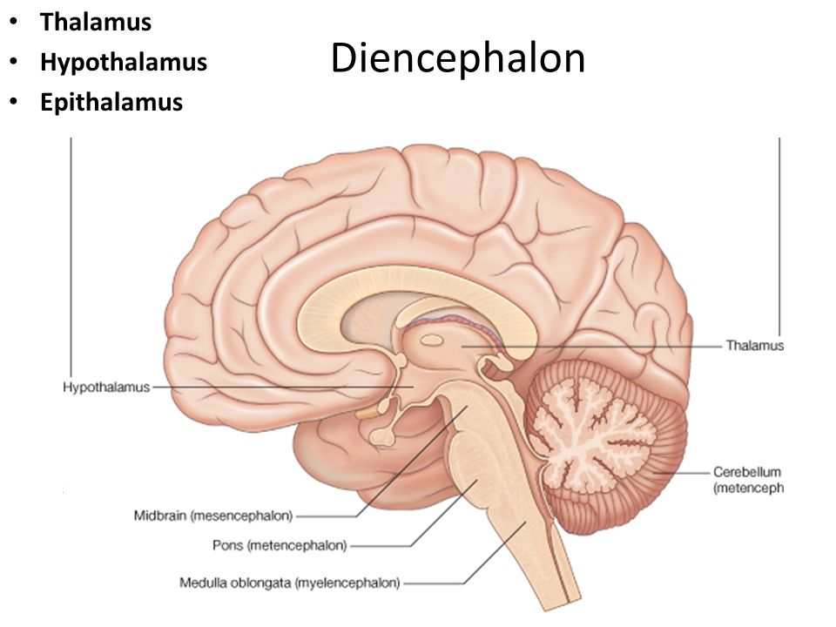
Regions of the Brain
Cerebrum :judgment, memory, association & critical thinking, highest levels of thought (lobes of the brain)
Diencephalon: posterior part of the forebrain with three endocrine glands
Thalmus: sensory “traffic director”
Hypothalmus: controls HR, BP, body temperature, hormones, hunger, thirst and digestion (vital body functions)
Pineal: circadian rhythm

Slide 8
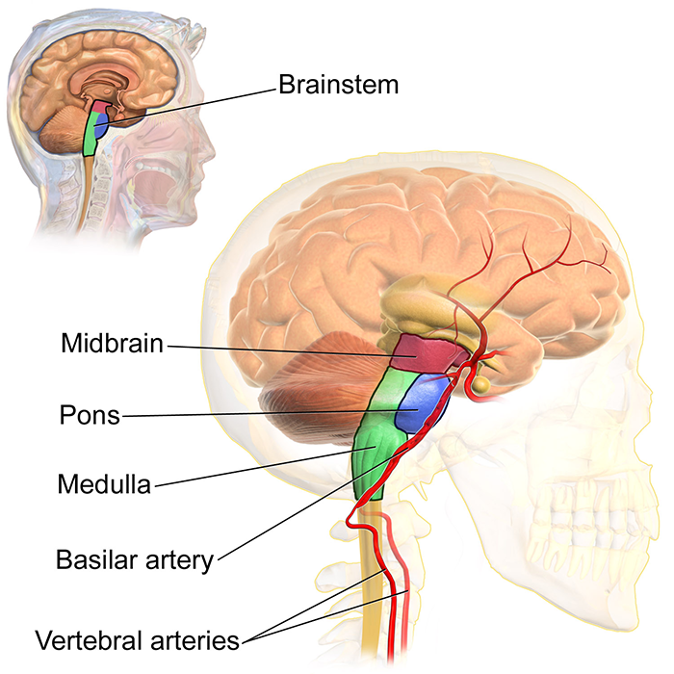
Regions of the Brain
Brain Stem: connects the cerebrum with the spinal cord & controls vital signs and sleep patterns
Pons: “bridge” where nerves cross over
Midbrain: passage way for electrical impulses
Medulla Oblongata: vital functions (RR, HR, BP, temp)

Slide 9
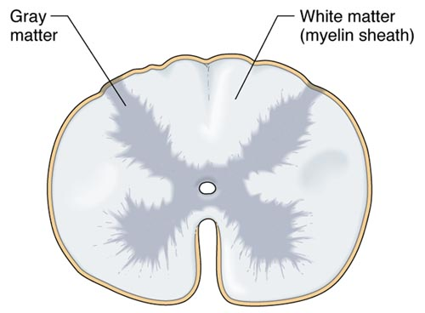
CNS: The Spinal Cord
Primary Functions
Transmits nerve impulses between the brain, limbs, and lower part of the body
Protected by CSF and the spinal column
Composed of neural tissue

Slide 10
PNS
All nerves outside CNS
12 pairs of cranial nerves
31 pair of spinal nerves

Slide 11
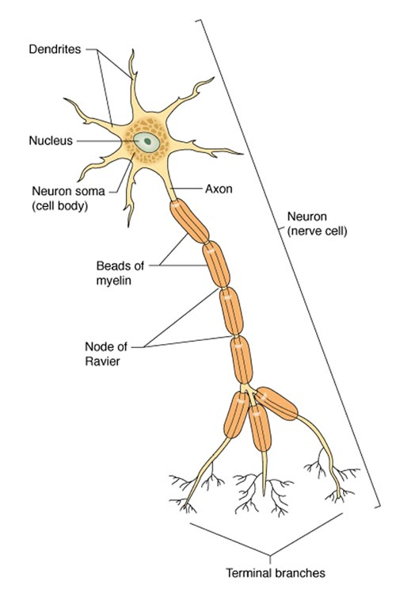
PNS: The Nerves
Primary Functions
Receive and transmit messages to and from all parts of the body.
Neuron: basic cell of the nervous system (nerve cell)
Afferent nerves: sensory nerves (example: touching a hot object is sensed by the brain as hot to the touch)
Efferent nerves: motor nerves (example: your hands pull away from the hot cup once touched)

Slide 12
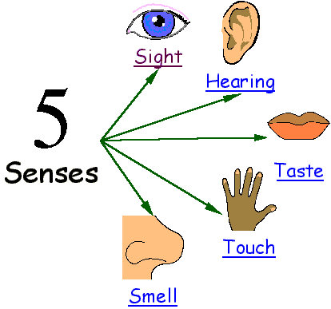
Sensory Organs and Receptors
Primary Functions
Receive external stimulation and transmit these stimuli to the sensory neurons.
Eyes (sight)
Ears (hearing)
Nose (smell)
Skin (touch)
Tongue (taste)

Slide 13
Flipped Classroom: Define the following for the upcoming lesson
Meningitis
Alzheimer’s Disease
Parkinson’s Disease
Tetanus
Shingles
Coma
Dementia
Amnesia
Migraine
Cerebral Aneurysm
Spina Bifida
Epilepsy
Seizure (all types)
Aura
Stroke
TIA
Concussion
Syncope
Paraplegia
Bell’s Palsy
Multiple Sclerosis
Subdural hematoma

