Slide 1
Chapter 9 THE NERVOUS SYSTEM
Somatic Diseases and Conditions

Slide 2
Somatic Diseases & Conditions
Somatic diseases have physical signs and symptoms. Examples include (but are not limited to) pain, fatigue, and dizziness.

Slide 3
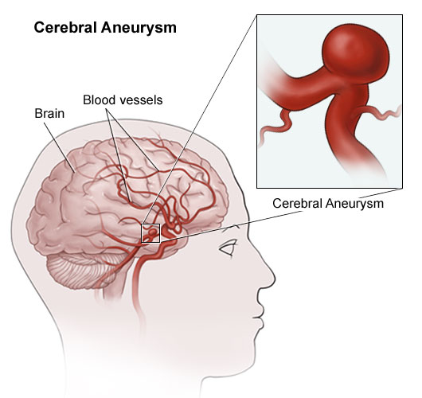
Somatic Diseases and Conditions
Aneurysm- localized dilation of a blood vessel, usually occurring in an artery
Amyotrophic Lateral Sclerosis(ALS)- muscular weakness and atrophy with involuntary contractions and excessive reflexes; caused by the degeneration of motor neurons in spinal cord & brain. What is another name for this disease?
Syncope- fainting, temporary LOC due to inadequate blood flow to the brain.

Slide 4
Somatic Diseases and Conditions

Slide 5
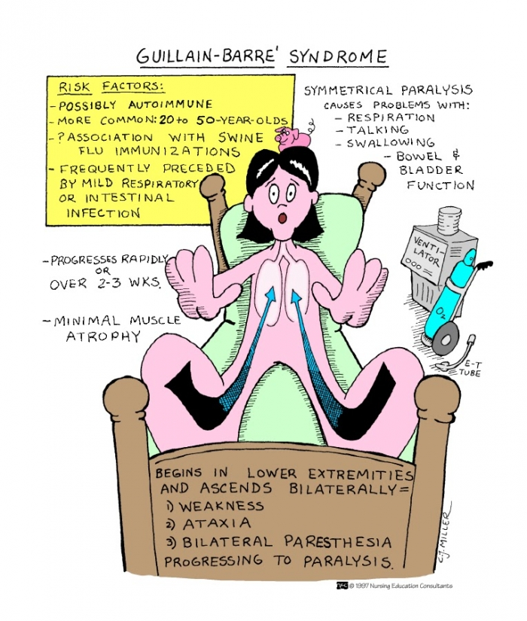
Somatic Diseases and Conditions
.
.
Guillain-Barre- polyneuritis usually occurring from an infection.
progressive muscle weakness that could lead to paralysis
Multiple Sclerosis (MS)-chronic, slow progressive disease of CNS marked by demyelination of glial patches called plaques.
Symptoms are weakness, unsteady gait, uncoordinated movements and fatigue.

Slide 6
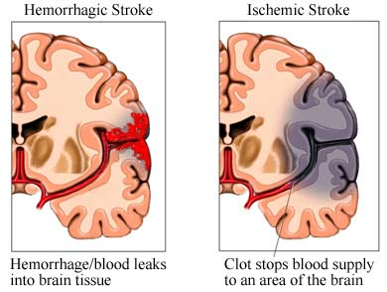
Somatic Diseases and Conditions
TIA: (transient ischemic attack)
“mini stroke”
Brief stoppage of blood flow to brain
Warning sign of a CVA
CVA (stroke)
Death of brain tissue to loss of blood flow to the brain
Arterial blockage = ischemic stroke
Arterial rupture = hemorrhagic stroke

Slide 7
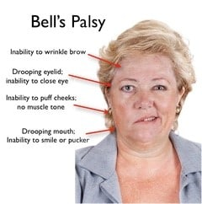
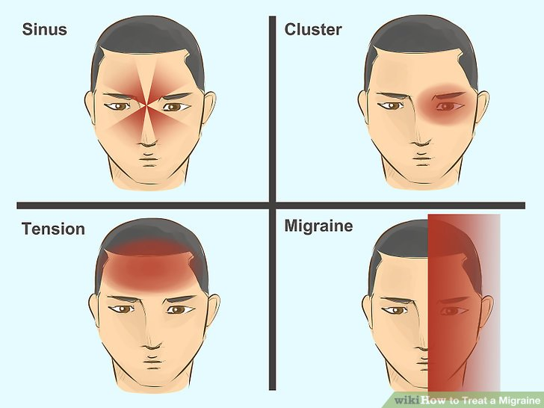
Somatic Diseases and Conditions
Bell’s Palsy-
unilateral paralysis of the nerves that control the facial muscles.
Migraine: intense headache that produces pain to one area of the head
Nausea/vomiting common
Hypersensitivity to light

Slide 8
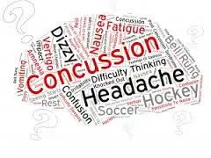
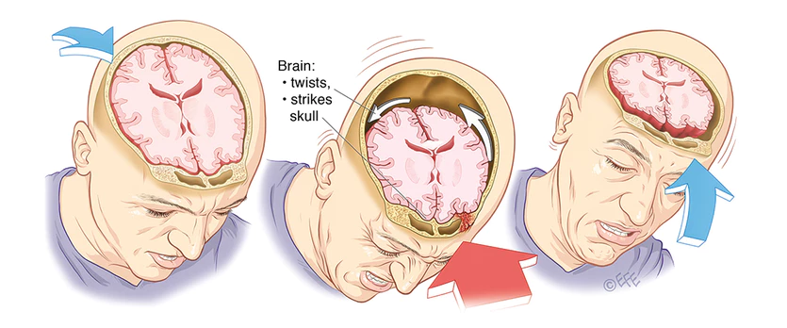
Somatic Diseases and Conditions: Concussion
Concussion: (also known as TBI) is caused by a violent blow or shaking to the head.

Slide 9
Somatic Diseases and Conditions.
Paralysis- temporary or permanent loss of voluntary movement.
Paraplegia- loss of voluntary movement in the lower half of the body including both legs, often result of spinal cord injury.
Quadriplegia- paralysis of all four limbs.
Hemiplegia-paralysis of one side of the body.
Paresthesia- sensation of numbness, prickling or tingling, usually in the upper or lower extremities; caused by irritation of, or injury to sensory nerves or nerve roots.

Slide 10
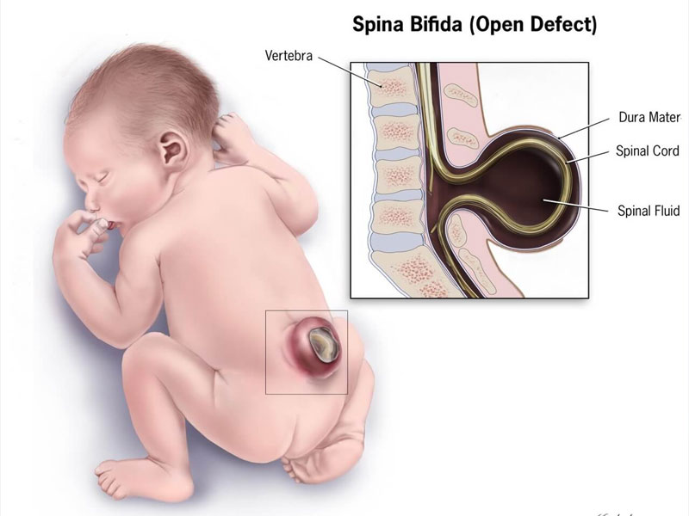
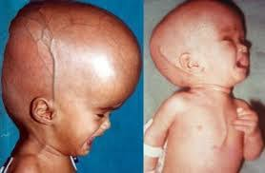
Somatic Diseases and Conditionsc Diseases and Conditions
Spina Bifida- “split spine”
congenital defect
part of the membrane covering the spinal cord protrudes through a gap in the spine.
Hydrocephalus- accumulation of excess CSF inside the ventricles of the brain
Results in cephalomegaly
Brain damage possible in young children.

Slide 11
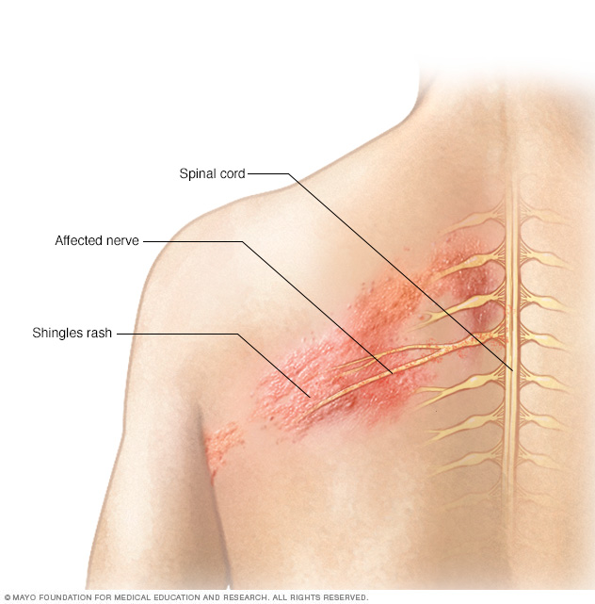
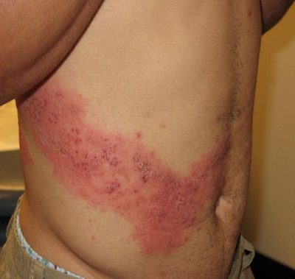
Somatic Diseases and Conditionsc Diseases and Conditions
Shingles- painful rash along peripheral nerve tracts, caused by varicella zoster virus(VZV).
Coma: state of extended unconsciousness caused by a medical event such as TBI, CVA, diabetes, or infection.

Slide 12
Somatic Diseases and Conditions.
Seizure- disruption of electrical activity in the brain that produces physical and mental changes; convulsions, sensory disturbances, LOC.
Aura- subjective sensation often occurring just before a migraine or seizure; flashing lights, numbness, tingling or peculiar odor.
https://www.youtube.com/watch?v=LN5mkFz0K44

Slide 13
Epilepsy- neural cells become disrupted, causing seizures, limb twitching and occasionally LOC.
Grand mal seizure: also known as tonic-clonic seizures
Severe and violent muscle movements
Petit mal seizure: (absence epilepsy) sudden, temporary loss of consciousness, lasting only a few seconds.
Seizures are very mild
No convulsion movements
Focal seizure: also known as a partial seizure
Limb jerking, facial twitching
Hallucinations, blushing of skin

Slide 14
Somatic Diseases and Conditions
Dementia-group of symptoms that interfere with memory and affect daily life
Amnesia - disturbance in the memory marked by a total or partial inability to recall past experiences
Delirium-mental confusion and agitation
Hallucinations and illusions possible

Slide 15
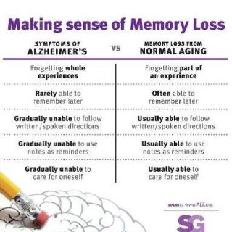
Alzheimer’s Disease (AD) - Degenerative changes in the brain structure that lead to dementia
progressive memory loss, impaired cognition, and personality changes, gait changes

Slide 16
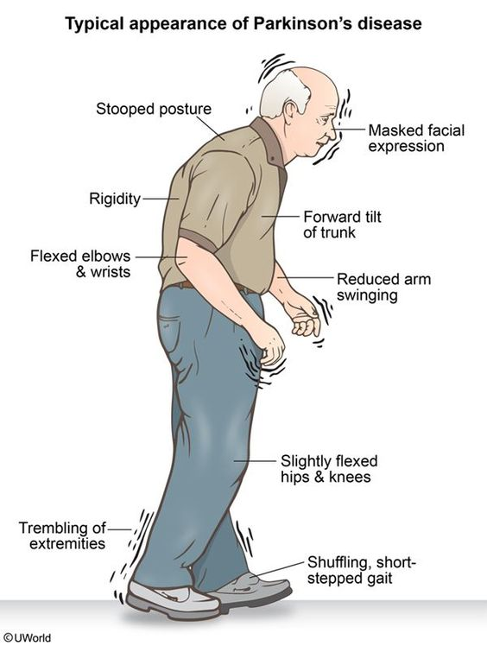
Somatic Diseases and Conditions
Meningitis - inflammation of the meninges of the brain or spinal cord
Parkinson’s Disease (PD) - chronic, degenerative CNS disorder.
Characterized by fine muscle tremors, masklike facial expression, and a shuffling gait

Slide 17
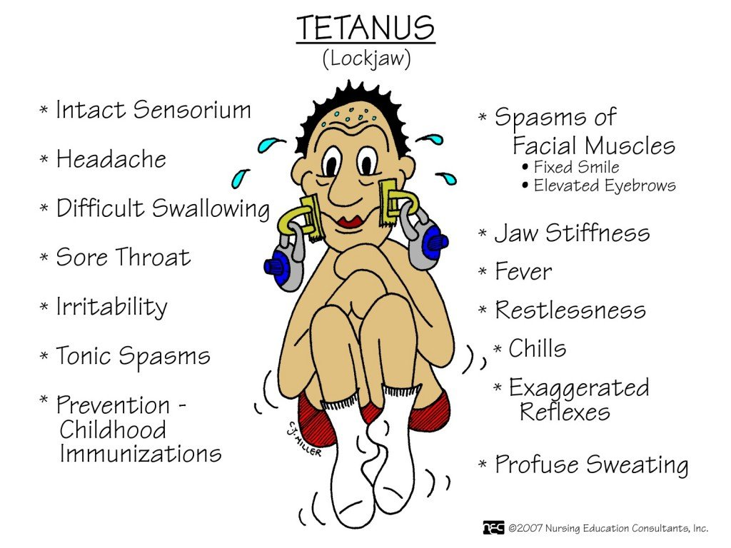
Somatic Diseases and Conditions
Tetanus: infection caused by bacteria found in the environment that affects nerve conduction (not spread person to person)
Also known as “lockjaw”
Symptoms include muscle tightening, seizures, fractures, fever, and painful muscle spasms/jerking
Can be prevented by a vaccination
https://www.youtube.com/watch?v=RG9kR3rYZzA

Slide 18
Mental Disorders: Define/Describe (Do more than unabbreviate the condition!)
Anxiety Disorders
GAD
OCD
PD
Phobia
PTSD
Developmental Disorders
ADHD
ASD
Dyslexia
ID
Mood Disorders
Bipolar
Depression
SAD
Psychotic disorders
Postpartum psychosis
Schizoaffective disorder
Schizophrenia
Substance abuse disorders

Slide 19
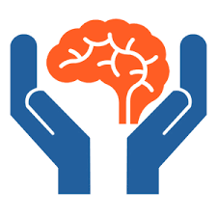
The Nervous System
MENTAL DISORDERS & CONDITIONS

Slide 20
Mental Disorders Anxiety Disorders: excessive worry, nervousness or uneasiness
Panic disorder- sudden recurring attacks of intense anxiety and fear
may mimic s/s of a heart attack
Sense of loss of control
PTSD- condition resulting from an extremely traumatic experience.
OCD- irrational thoughts and fears causing one to perform repetitive actions
excessive washing due to a fear of becoming contaminated or of germs
Symptoms include heart palpitations, chest pain, tremors, nausea, headaches & sweating
.https://youtu.be/dSZNnz9SM4g
Phobia- exaggerated fear of a specific object or situation that causes anxiety and panic.
Generalized Anxiety Disorder (GAD)-characterized by excessive worry that is not restricted to specific situations or objects
heart palpitations, chest pain, tremors, sweating, nausea, headaches.

Slide 21
Mental Disorders- Developmental
Developmental disorders: characterized by disruption of normal childhood development
Dyslexia: learning disorder that makes it difficult to recognize and comprehend written language
ADHD- (attention-deficit hyperactivity disorder)
mental disorder where person is easily distracted, hyperactive, and has a lack of impulse control.
ASD: (Autism Spectrum Disorder)
Disability with difficulty communicating with others
Inability to maintain eye contact
Repetitive behavior
Preoccupation with objects
Intellectual Disorder (ID): below average intelligence that causes one to be unable develop skills necessary for daily living on their own.

Slide 22
Mental Disorders- Mood (alternating periods of depression and/or elation)
Bipolar (manic- depressive disorder)
Alternating periods of depression (emotional low) and mania (emotional high)
Depression:
Persistent feelings of sadness, worthlessness and lack of interest
AKA “clinical depression” or “ major depressive disorder”
SAD(Seasonal Affective Disorder)
form of depression that occurs during fall and winter as a result of less exposure to the sun

Slide 23
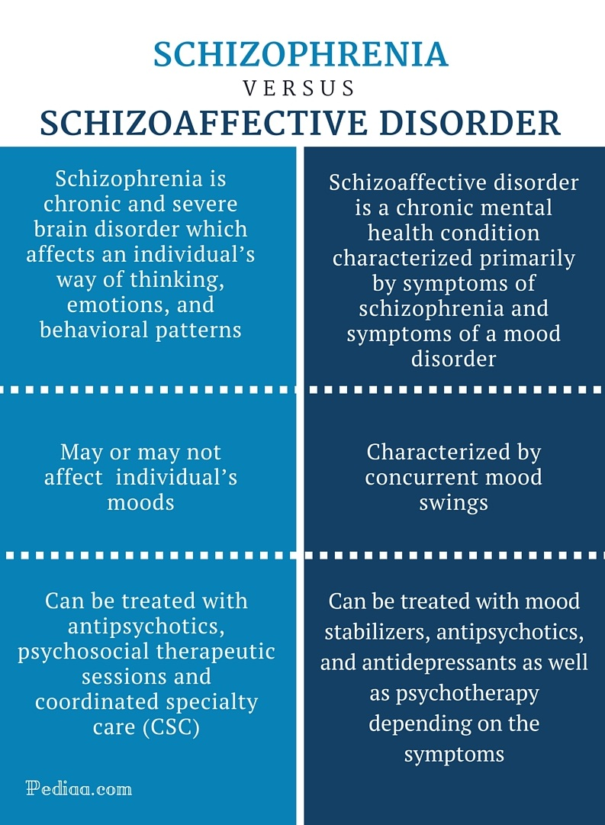
Psychotic Disorders: group of mental conditions characterized by loss of touch with reality, hallucinations, delusions
Postpartum psychosis: rare condition that develops a week after childbirth
Confusion, hallucinations, obsessive thoughts, delusions, paranoia, and sleep disturbances
Can have thoughts about harming infant or self

Slide 24
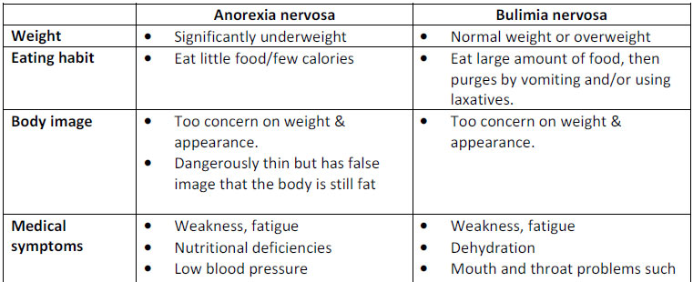
Eating Disorders: unhealthy focus on food and weight
Anorexia Nervosa

Slide 25
Tests & Procedures: describe and define the following in your journal
CBT
ECT
Light therapy
Psychotherapy
*Add all “fascinating” facts to your journal
*You are also responsible for all chapter medications (know by the class of drug)
EEG
Cerebral Angiography
Lumbar Puncture
PET
Babinski Sign
DTR
CSF shunt
Carotid endarterectomy
Nerve block

