Slide 1
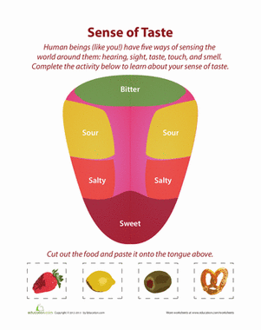
Draw the Tongue
Color & label each area
Draw a food that would be under each category

Slide 2
5 Senses Project
You will be assigned a structure within the 5 senses (ear, outer or inner eye, skin section, & tongue)
You and your partner are to create a 3-D model of the structure
Suggested supplies include (but are not limited to):
Edibles (candy, baked goods, icing, fruit/veggies, rice krispy treats, granola, crackers, cereal, etc…)
Modeling clay, playdough, paint, glitter
Buttons, beads, fabrics, paper goods
popsicle sticks, toothpicks, foil, plastic ware
You are responsible for supplying the project base (foil pan, cardboard box, shoebox, etc….)

