Slide 1
Chapter 11
The Endocrine System

Slide 2
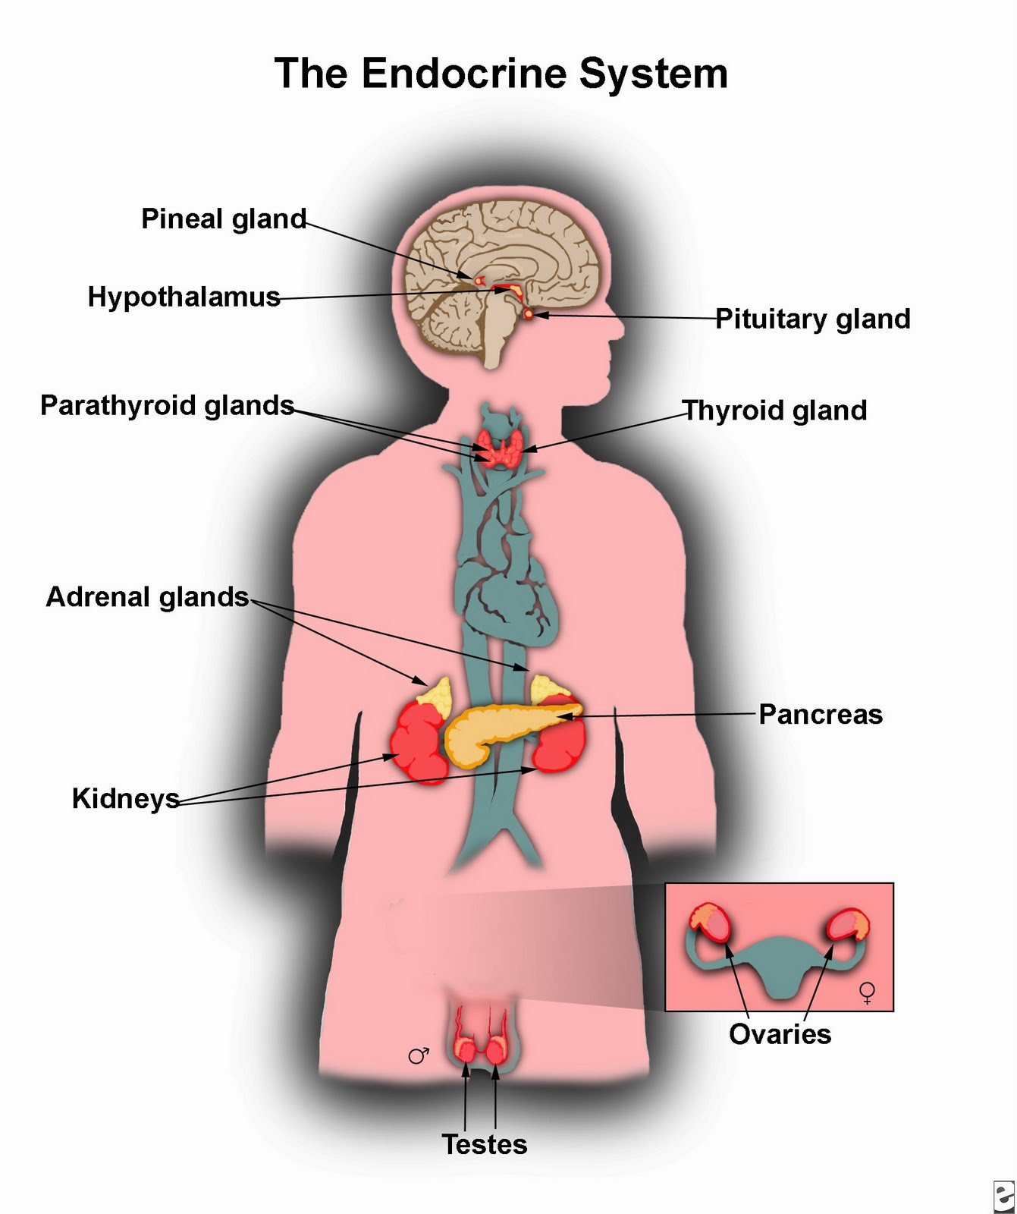
Function of the Endocrine System
Maintains homeostasis
Produce hormones that are secreted directly into the bloodstream.

Slide 3
Hormones
Hormones: chemicals that are secreted to affect body functions
Exocrine glands: secrete hormones via ducts. (example= sweat/sudoriferous glands)
Endocrine glands: secrete hormones directly into the bloodstream
The pancreas is the only structure that is both and exocrine AND endocrine gland

Slide 4
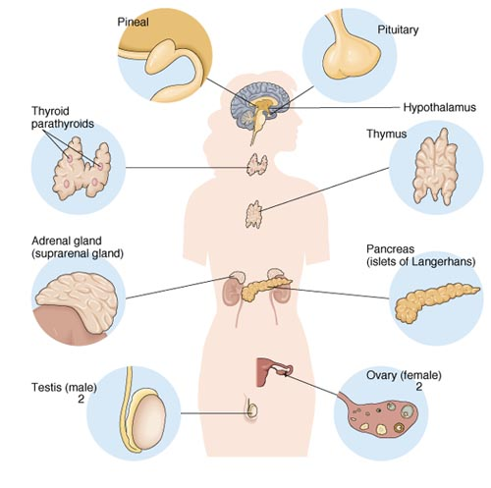
Structures of the Endocrine System
One Pituitary Gland
One Thyroid Gland
Four Parathyroid Glands
Two Adrenal Glands
One Pancreas
One Thymus
One Pineal Gland
Two Gonads

Slide 5
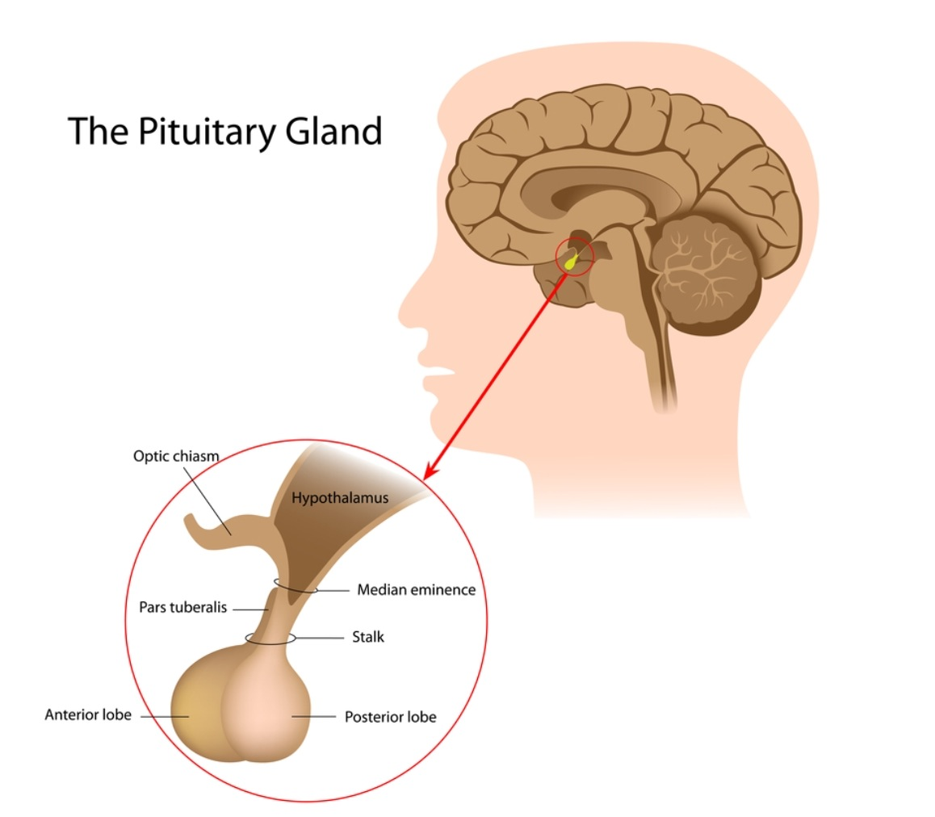
Pituitary Gland
Primary Function
Secretes hormones that control the activity of the other endocrine glands.
“Master Gland” of the endocrine system
Hormones= ACTH, FSH, GH, LH, MSH, Prolactin, TSH, ADH, & oyxtocin

Slide 6
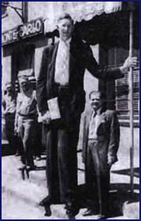
Pituitary Gland Pathologies
Acromegaly- enlargement of the hands and feet caused by excessive secretion of growth hormone after puberty
(acr/o=extremities) (-megaly=enlargement)
Gigantism- or giantism is overgrowth of the body caused by excessive secretion of the GH before puberty

Slide 7
Other Pituitary Gland “Pathologies”
Diabetes insipidus- caused by insufficient production of the ADH causing too much fluid to be excreted resulting in both:
Polydipsia- excessive thirst
Polyuria- excessive urination

Slide 8
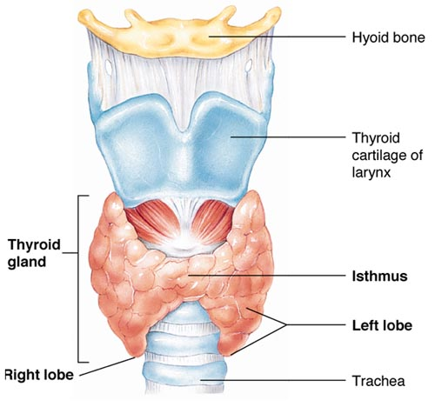
Thyroid Gland
Primary Functions
Stimulates metabolism, growth, temperature and the activity of the nervous system.
Dependent on iodine
Stimulates the deposit of calcium

Slide 9
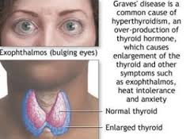
Thyroid Gland Pathologies

Slide 10
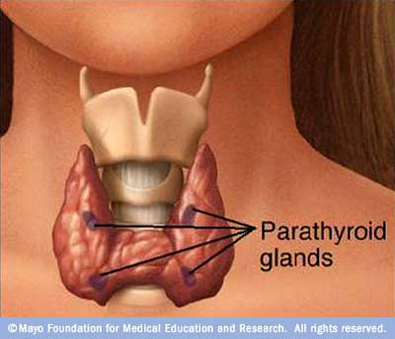
Parathyroid Glands
Primary Function
Regulate calcium levels throughout the body.
Stimulates the breakdown of bone
Hormone=PTH

Slide 11
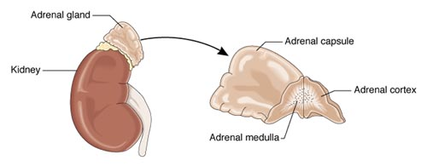
Adrenal Glands
Primary Functions
Regulate electrolyte levels.
Influence metabolism.
Respond to stress.

Slide 12
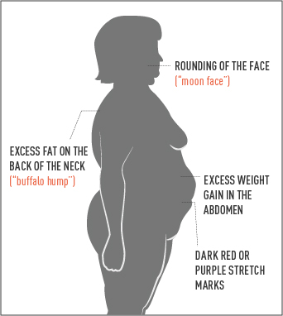
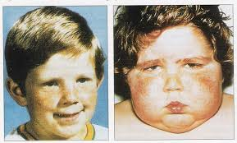
Adrenal Glands “Pathologies”
Cushing’s Syndrome “hypercortisolism”
From hypersecretion of cortisol or prolonged steroid use
s/s include fatigue, thin/bruised skin, hypertension and weight gain
Notes:
Aldosteronism
Primary aldosteronism
Secondary aldosteronism
Pheochromocytoma

Slide 13
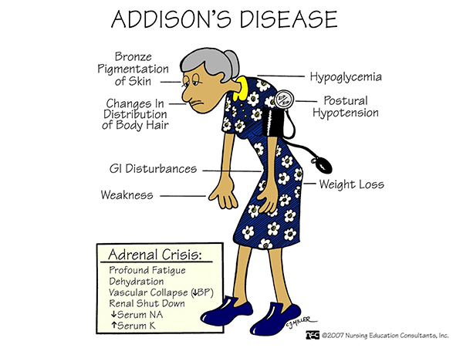
Adrenal Glands “Pathologies”
Addison’s Disease
Insufficient cortisol and/or aldosterone secretion
s/s include hypotension, hypoglycemia, fatigue, joint pain, loss of appetite
Notes:
Aldosteronism
Primary aldosteronism
Secondary aldosteronism
Pheochromocytoma

Slide 14
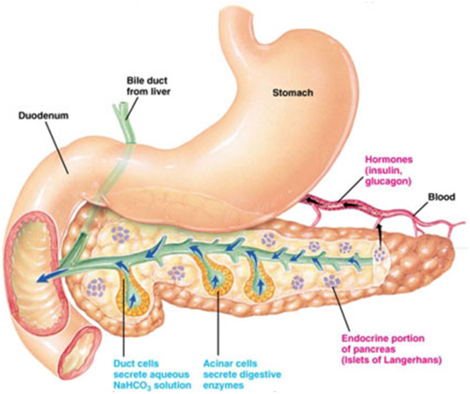
Pancreas: Pancreatic Islets
Primary Functions
Control blood sugar levels and glucose metabolism.
Hormones: glucagon & insulin

Slide 15
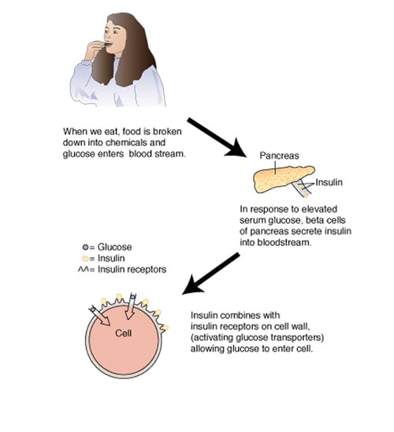
Pancreatic Islets “Secretions”
Glucagon:- secreted by the pancreas in response to low blood sugar
Insulin:- secreted by pancreas in response to high blood sugar.
**insulin allows glucose to enter cell for use as energy
Notes:
15

Slide 16
Pancreatic Pathologies: Diabetes Mellitus
A group of metabolic diseases characterized by hyperglycemia resulting from defects in insulin secretion, insulin action or both.
Type 1 (IDDM): insulin dependent diabetes mellitus
Type 2 (NIDDM): non-insulin dependent diabetes mellitus

Slide 17
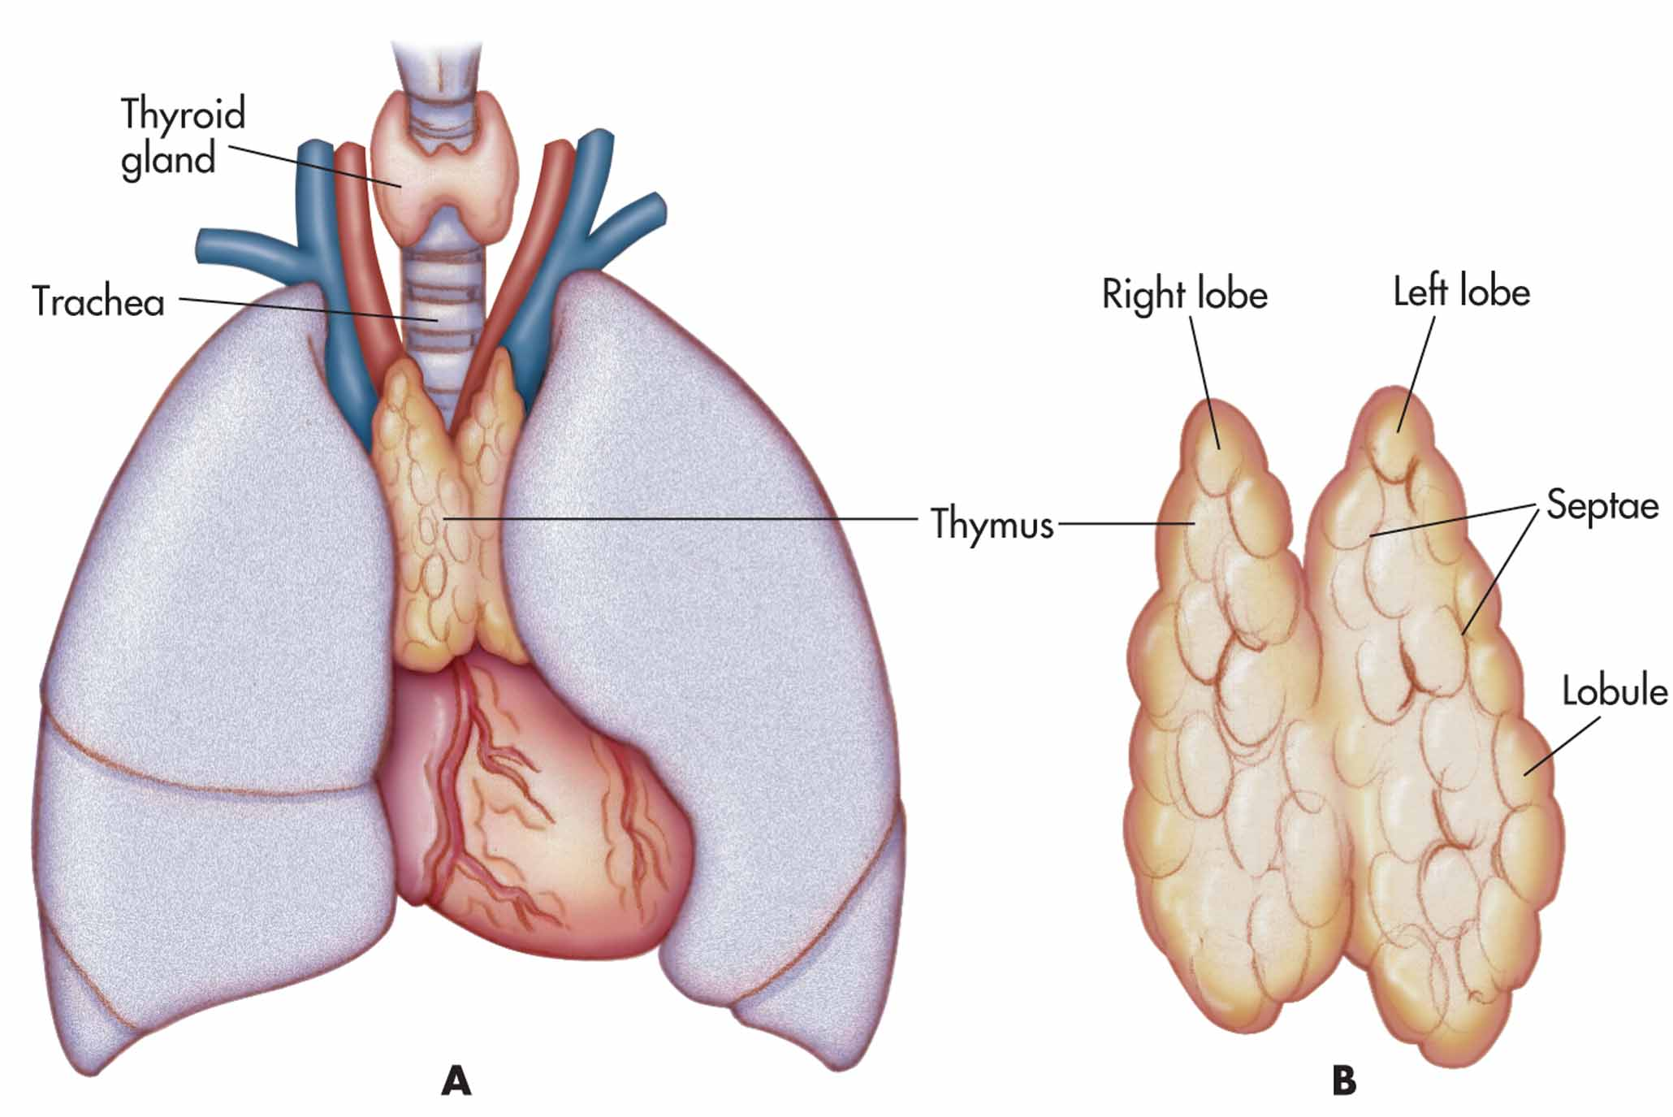
Thymus
Primary Function
Plays a major role in the immune reaction.
Located near the midline in the anterior portion of the thoracic cavity
Hormone= thymosin

Slide 18
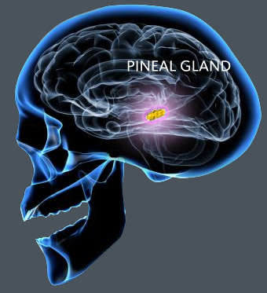
Pineal Gland
Primary Function
Influences the sleep-wakefulness cycle. (circadian rhythm)
Located in the central portion of the brain.
Hormone= melatonin

Slide 19
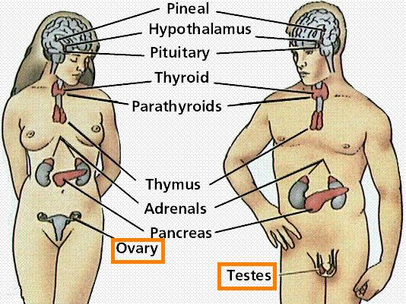
Gonads*
Primary Function
Regulate development of secondary sex characteristics.
Gamete producing gland, gamete is a reproductive cell. The sperm in the male and the ova (eggs) in the female
Related Combining Form
gonad/o
*Males: testicles (2)- secretes testosterone
*Females: ovaries (2)- secretes estrogen

Slide 20
Flipped Classroom : Describe each condition (list the related gland, hormone, & s/s)
Dwarfism
Tetany
Diabetic Ketoacidosis
Hirsutism
Thyrotoxicosis
Peripheral neuropathy
Exophthalmos
Edema
Hyperparathyroidism
Homework= Therapeutic Drugs

