Slide 1
THE REPRODUCTIVE SYSTEM
Function: to create a new human organism

Slide 2
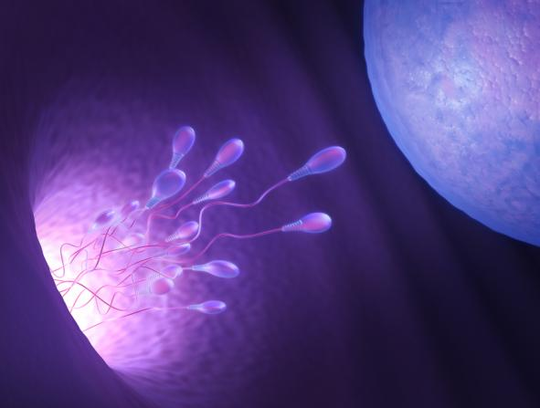
Functions of the Male Reproductive System
Facilitate conception
Produce sperm
Deliver sperm to female reproductive system
ktsdesign/Shutterstock.com

Slide 3
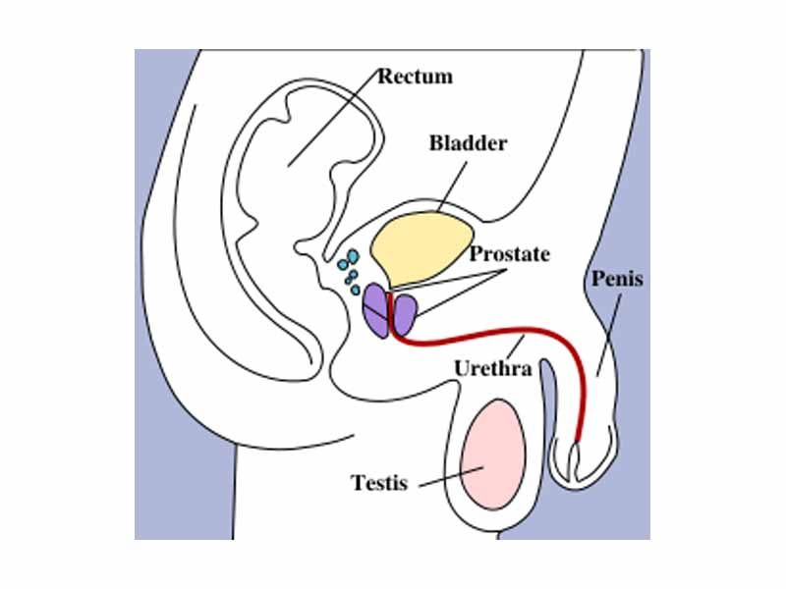
Primary Functions
Produce sperm and the male hormone testosterone.
AKA the male gonads
Scrotum: sac-like pouch that protects the testes
Related Combining Forms
orch/o, orchid/o
test/i, test/o, testicul/o

Slide 4
Scrotum and Testes
© Body Scientific International

Slide 5
Primary Functions
Used for sexual intercourse and urination.
Contains the male urethra
Related Combining Forms
pen/i
phall/i

Slide 6
Accessory Structures
Seminal vesicles—produce semen
Prostate gland—secretes a fluid that lowers the acidity of semen
Semen—sperm-containing fluid expelled during sexual intercourse

Slide 7
Diseases & Conditions of the Male Reproductive System (DESCRIBE: causes, s/s, and other names)
Anorchia
Azoospermia
BPH
Cryptorchidism
Infertility
Prostate cancer
Oligospermia
Testicular torsion
ED
STI
AIDS
Herpes genitalis
Genital Warts
Syphilis
Trichomoniasis
Testicular cancer
Hydrocele

Slide 8
THE FEMALE REPRODUCTIVE SYSTEM

Slide 9
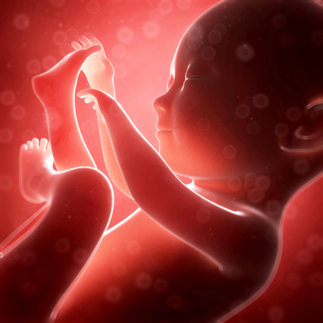
Functions of the Female Reproductive System
Produce new life
Manufacture sex cells and sex hormones
Support growth and development of embryo and fetus
Maintain life of newborn
Sebastian Kaulitzki/Shutterstock.com

Slide 10
Structures of the Female Reproductive System
© Body Scientific International

Slide 11
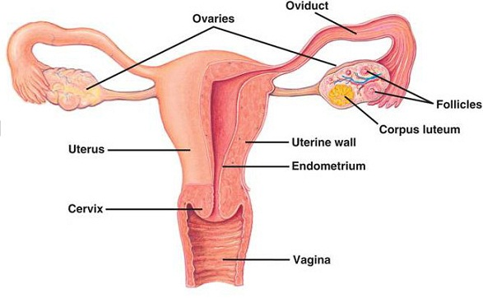
Primary Functions
Produce ova (eggs) and female hormones.
Related Combining Forms
oophor/o
ovari/o

Slide 12
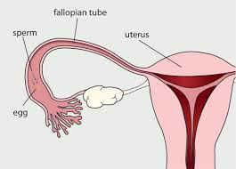
Primary Functions
Draw ova in using fimbriae
Peristalsis helps the ovum move toward the uterus
Place where fertilization takes place
Related Combining Form
salping/o

Slide 13
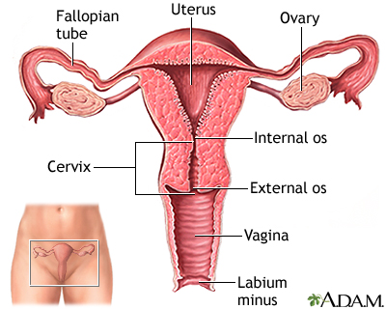
Primary Functions
Protects and supports the developing child.
Related Combining Forms
hyster/o
metr/o, metri/o
uter/o
Menstruation: monthly shedding of the innermost layer of the uterus (endometrium)

Slide 14
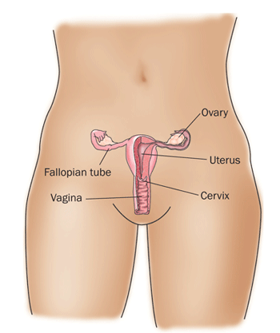
Primary Functions
Used for sexual intercourse.
Birth canal
Serves as a channel for menstrual flow
Related Combining Forms
vagin/o
colp/o

Slide 15
Mammary Glands
Lobes and lobules
Lactiferous ducts
Areola
Secrete colostrum
© Body Scientific International

Slide 16
Remember This?
The uterus is made up of three layers. What are they?
perimetrium, myometrium, and endometrium
What is colostrum, and what is its purpose?
Colostrum is a thin, yellow fluid secreted from the female breast for the first few days of nursing; it provides nutrition and fortifies the newborn’s immune system

Slide 17
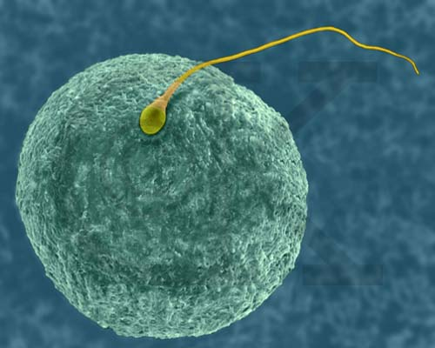
Ovulation
release of a mature egg
Fertilization - “Conception”
Zygote: fertilized egg
Fetus: developing child from 9th week of pregnancy to birth.
Placenta
Temporary organ that forms in the uterus to nourish the fetus.
the “afterbirth” expelled after delivery.

Slide 18
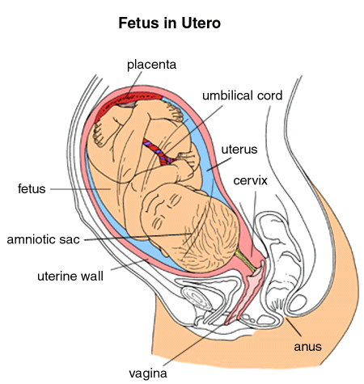
Gestation period of development of the child in the mother’s uterus. (Pregnancy)
Lasts approximately 280 days.
Lasts 40 weeks
divided into 3 trimesters (3 months each)
Quickening - fetal movement
Starts around 16th – 20th week

Slide 19
Remember This?
Identify the structures that protect and nourish the developing fetus.
Placenta
Umbilical cord
Amniotic fluid
Amnion
Uterus
Chorion
Cavity of uterus
Cervix
© Body Scientific International

Slide 20
Pregnancy: Conception
© Body Scientific International

Slide 21
Pregnancy: Gestation
© Body Scientific International

Slide 22
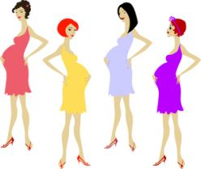
Nulligravida (nulli-: none, gravida:pregnant) is a woman who has never been pregnant
Nullipara (-para: live birth) is a woman who has never given birth to a viable child
Primagrava is a woman during her first pregnancy
Primapara (prim/a, prim/i: first) is a woman who has had one child
Multiparous(multi- : many, -parous: bear child) is a woman who has given birth 2 or more times

Slide 23
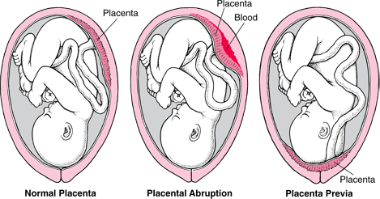
of pregnancy
Abruptio placentae – placenta separates from the uterine wall before birth of the fetus.
Placenta previa – abnormal implantation of the placenta in the lower portion of the uterus. Usually requires c-section.

Slide 24
Define/Describe the following diseases and conditions
Eclampsia
Ectopic Pregnancy
Abruptio Placentae
Endometriosis
PMS
PID
Placenta Previa
PCOS
Prolapsed Uterus
Stillbirth
TSS
Preeclampsia
Pseudocyesis
Miscarriage
STI
HPV
Mastalgia
Menometrorrhagia
Meconium aspiration syndrome

Slide 25
Label the System: Word bank
Male
Testicles
Vas deferens
Foreskin
Urethra (2)
Scrotum
Seminal Vesicle
Bladder
Penis
Glans Penis
Prostate
Female
Cervix
Fimbriae
Uterus
Ovary
Vagina
Fallopian tube

Slide 26
TEST REVIEW
Be able to describe each & know the function of the structures:
Prostate
Uterus
Fallopian tubes
Ovaries
Ova
Sperm
Testosterone (define)
Estrogen (define)
Urethra
Testes
Study your lecture vocabulary
Be able to label anatomy diagrams for both male & female
Study your terminology!!!

