Slide 1
Chp 12: The Urinary System
Functions:
Filtration
Waste storage & excretion
Hormone production
Homeostasis maintenance

Slide 2
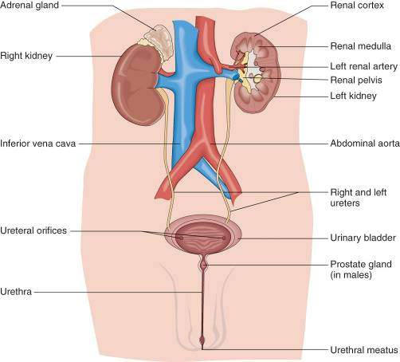
Primary Structures of the Urinary System (Excretory System)

Slide 3
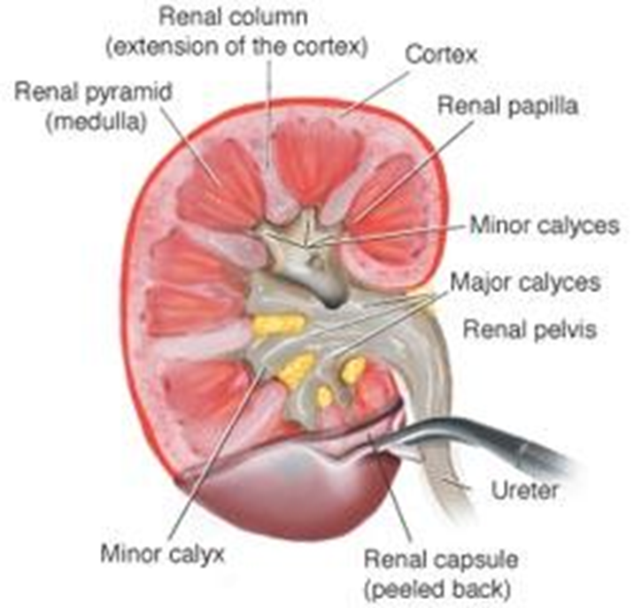
Structures of the Urinary System: Kidneys
Primary Functions
Filter the blood to remove waste products.
Maintain electrolyte concentrations.
Related Combining Forms
nephr/o
ren/o

Slide 4
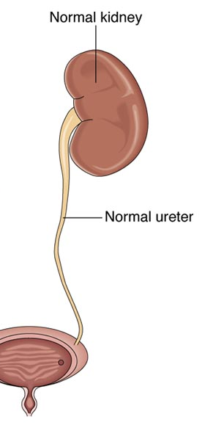
Ureters
Primary Function
Transport urine from the kidneys to the bladder.
Related Combining Form
ureter/o

Slide 5
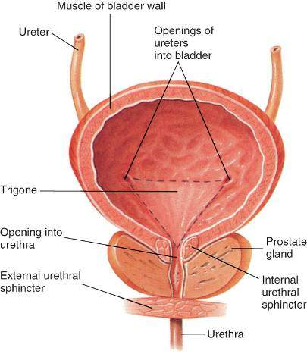
Urinary Bladder
Primary Function
Stores urine until it is excreted.
Related Combining Form
cyst/o

Slide 6
Urethra
Primary Function
Transports urine from the bladder where it is excreted from the body.
Related Combining Form
- urethr/o

Slide 7
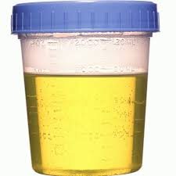
Urine
Primary Function
Liquid waste product produced by the kidney
Related Combining Forms
ur/o, urin/o, -uria

Slide 8
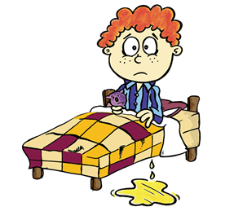
Urination (define together)
Diuresis
Enuresis
Oliguria
Nocturia
Urinary Retention
Incontinence
Stress incontinence
Urge incontinence

Slide 9
Treatment Procedures
Transplant – kidney; remove and replace the kidneys from a donor
Lithotripsy – destruction of the kidney stone through the use of ultrasonic waves
Nephrolithotomy – surgical removal of kidney stones through a surgical incision

Slide 10
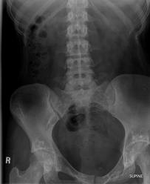
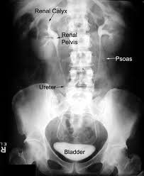
Diagnostic Procedures
KUB: x-ray of abdominopelvic cavities to include the kidneys, ureters and bladder
Intravenous Pyelogram (IVP): contrast medium injected into the veins and a series of x-rays are taken to view the urinary organs

Slide 11
Flipped Classroom: Define/Describe the Diseases and Conditions
Nephrolithiasis
PKU
PKD
Pyelonephritis
Wilms tumor
UTI
Cystocele
Renal hypertension
Renal cell carcinoma
Nephrosclerosis
Nephritic Syndrome
Cystolithiasis

